Slide 1
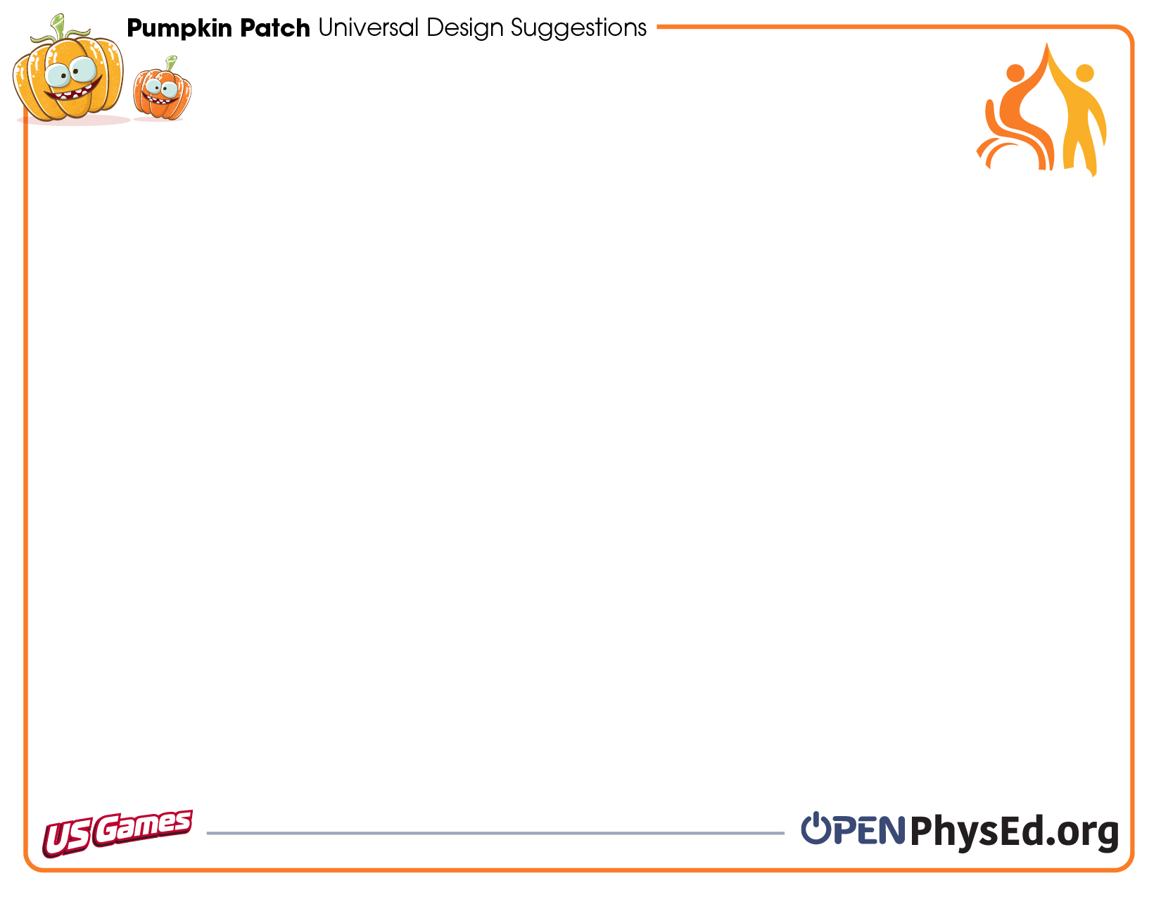
Universal Design for Learning (UDL) is a strategy for eliminating instructional and environmental barriers for every member of a learning community in order to meet the needs of all students across the continuum of physical, intellectual, and emotional abilities.
Equipment | Rules | Environment | Instruction
Use large, brightly colored organizational markers to help students stay safely in personal space. Use different colored cones or spots to identify personal and general space. Use spot markers to create movement or travel routes. Let students choose equipment that meets their needs. | Change rules to reflect equity of skill acquisition, mobility, and fitness level. Vary movement expectations to increase equity. For example, allow different locomotor movements or the use of assistive equipment. Adapt body positioning to student needs. For example, modify the game to play sitting. | Visually mark/define space in area with visual markers like cones, spot markers, visual signs/cues. Adjust lighting (e.g., brighter or lighter). Create visual pathways for travel using floor markers, wall markings, and other visual cues. Be sensitive to noise and volume tolerance when playing music. | Be flexible. Adjust as needed. One size doesn’t fit all. Establish consistent, predictable routines. Speak slowly & clearly with a well-defined beginning & end. Give 1-step vs multiple-step directions. Provide multiple forms of prompts cues — kinesthetic, visual, and auditory.
When UDL adaptations are not enough for accessing and developing equitable learning activities and assessments, and you feel that you need to do more for individual students, reach out to providers on the students’ IEP Teams.
You can also reach out to your school’s curriculum resource department in order to see how else you can modify instructional delivery to meet students’ needs. Students who have an IEP or a 504 will oftentimes have specific modifications and accommodations in their IEP based on individual needs.

