Slide 1
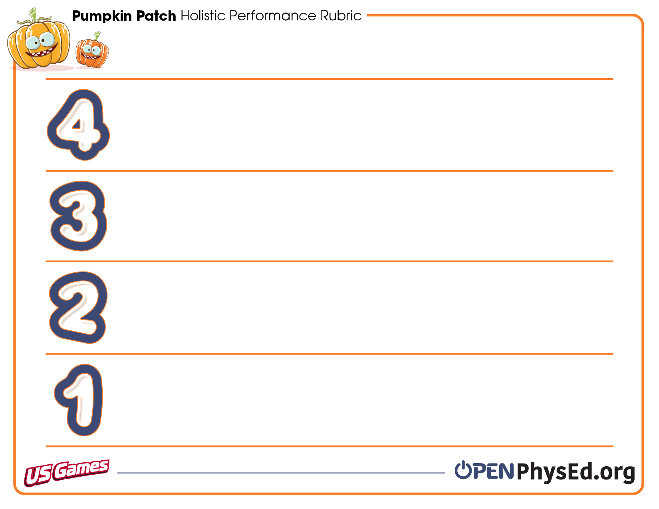
Score a perfect four! Read about what you need to do and then make it happen.
Every time that I come to physical education class, I demonstrate responsible behaviors and self-control. I demonstrate grit and determination and participate in all activities at a level that is good for my personal mental and physical health.
I recognize the connection between positive behaviors and fun for the entire class.
When I come to physical education class, I demonstrate responsible behaviors and self-control. I participate in all activities to the best of my ability. I can discuss what positive behaviors look like in physical education class.
When I come to physical education class, I work to demonstrate responsible behaviors. I still need reminders that help me behave in a responsible way. Sometimes I need reminders to help me continue participating in a positive way. I need reminders that my behavior can affect enjoyment for the entire class.
When I come to physical education class, I need reminders on how to demonstrate responsible behaviors and self-control. I need a lot of reminders that help me participate in a positive way. Sometimes I forget that my behavior does have an impact on the learning and enjoyment of my classmates.

