Slide 1
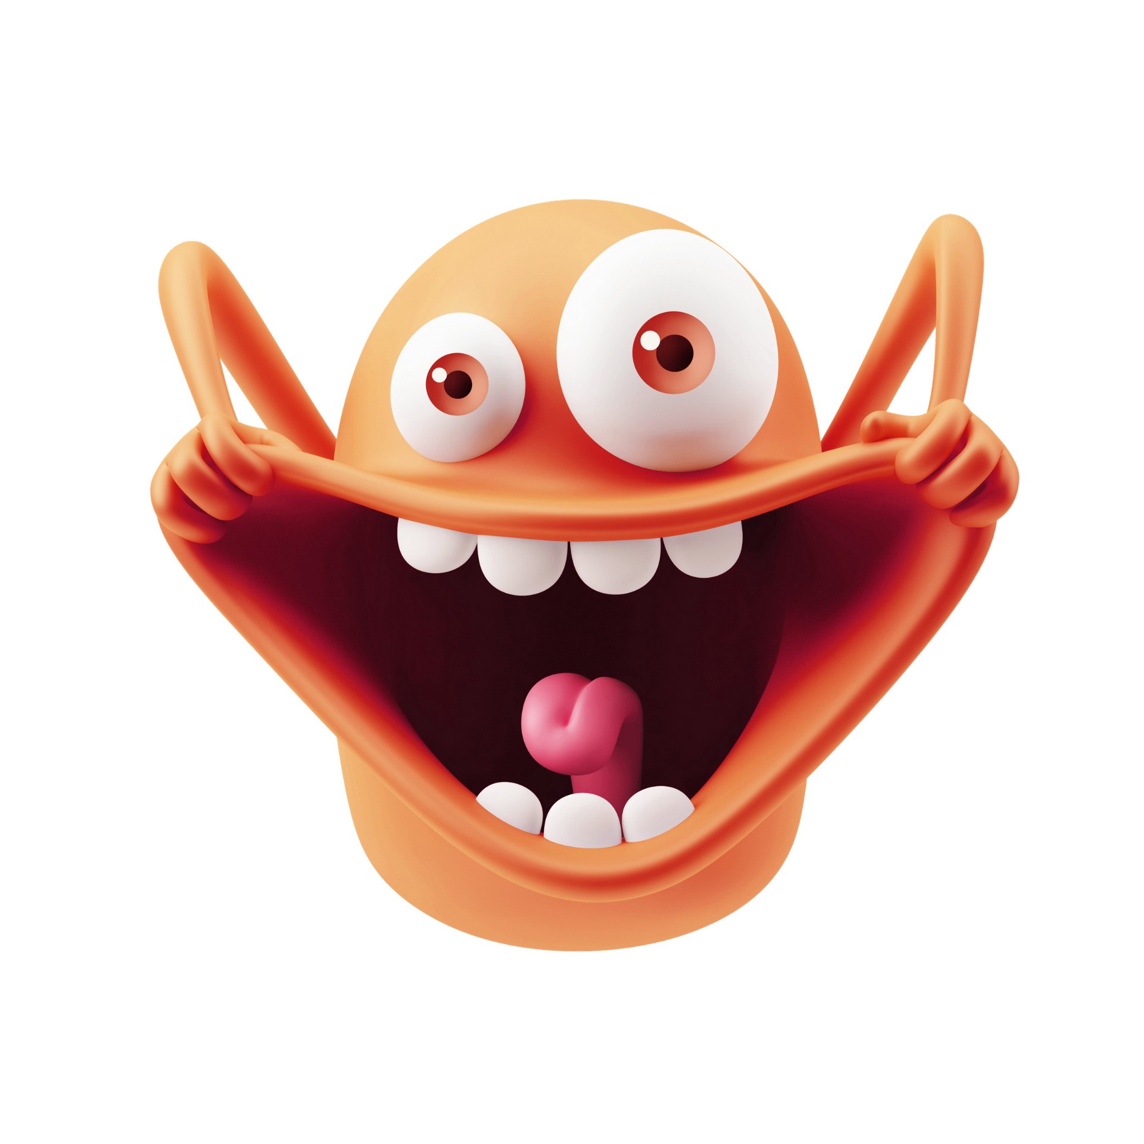
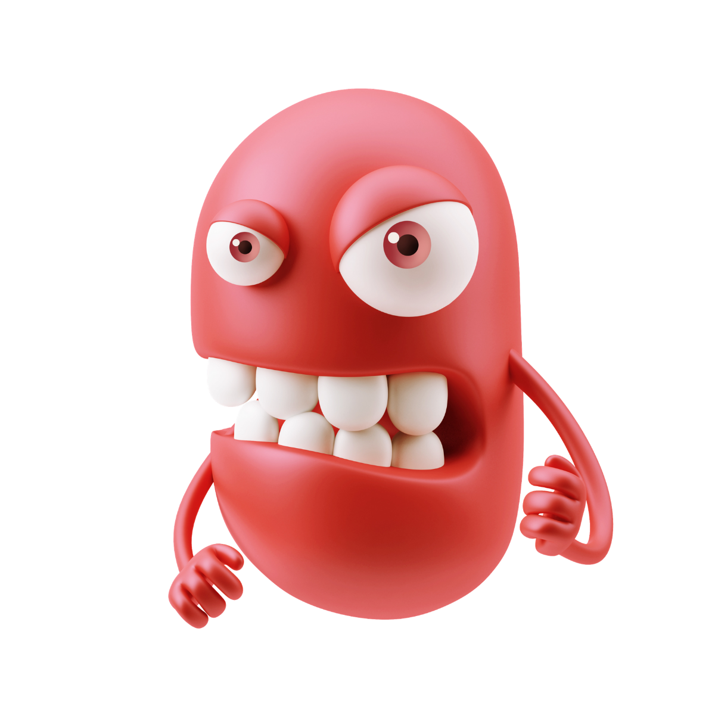
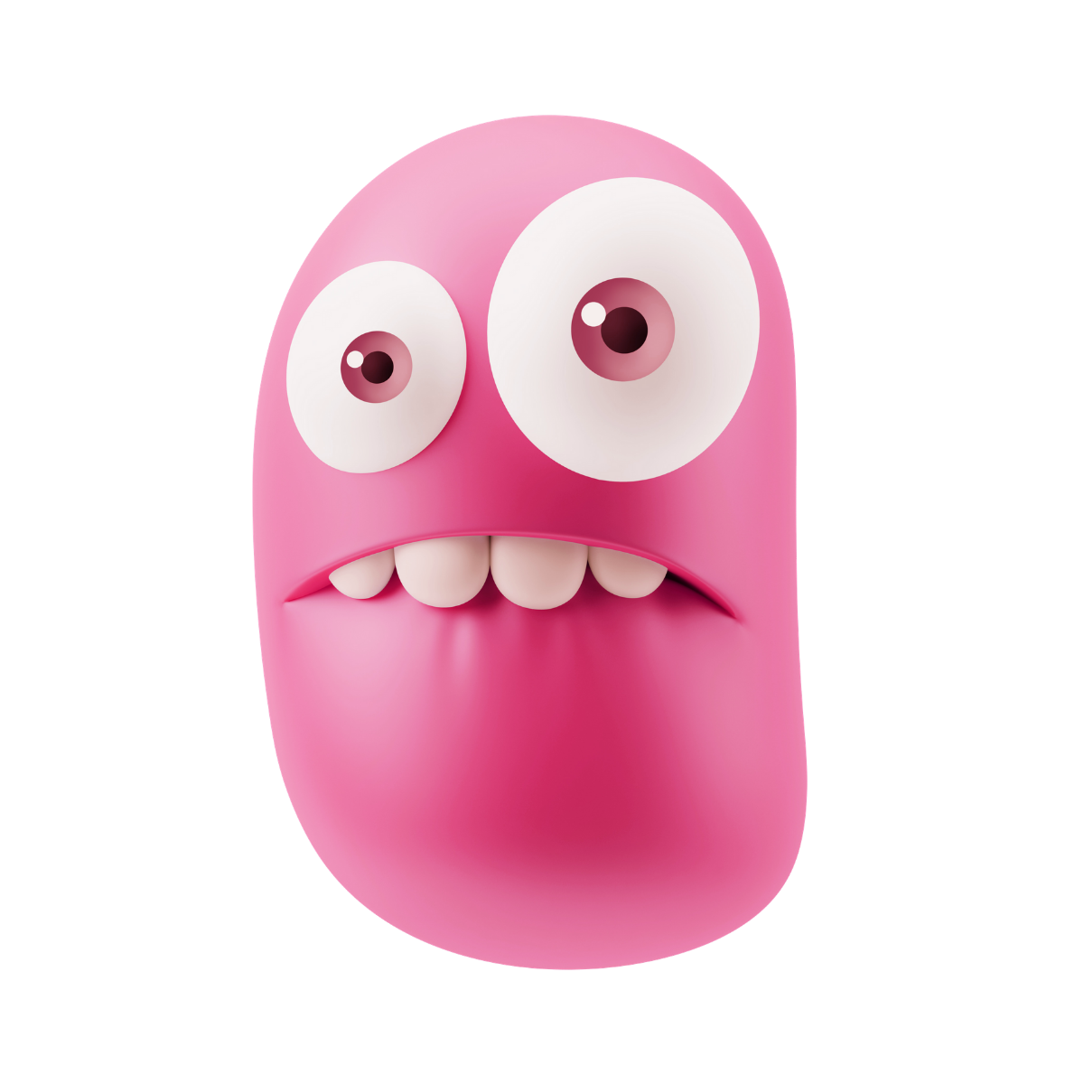
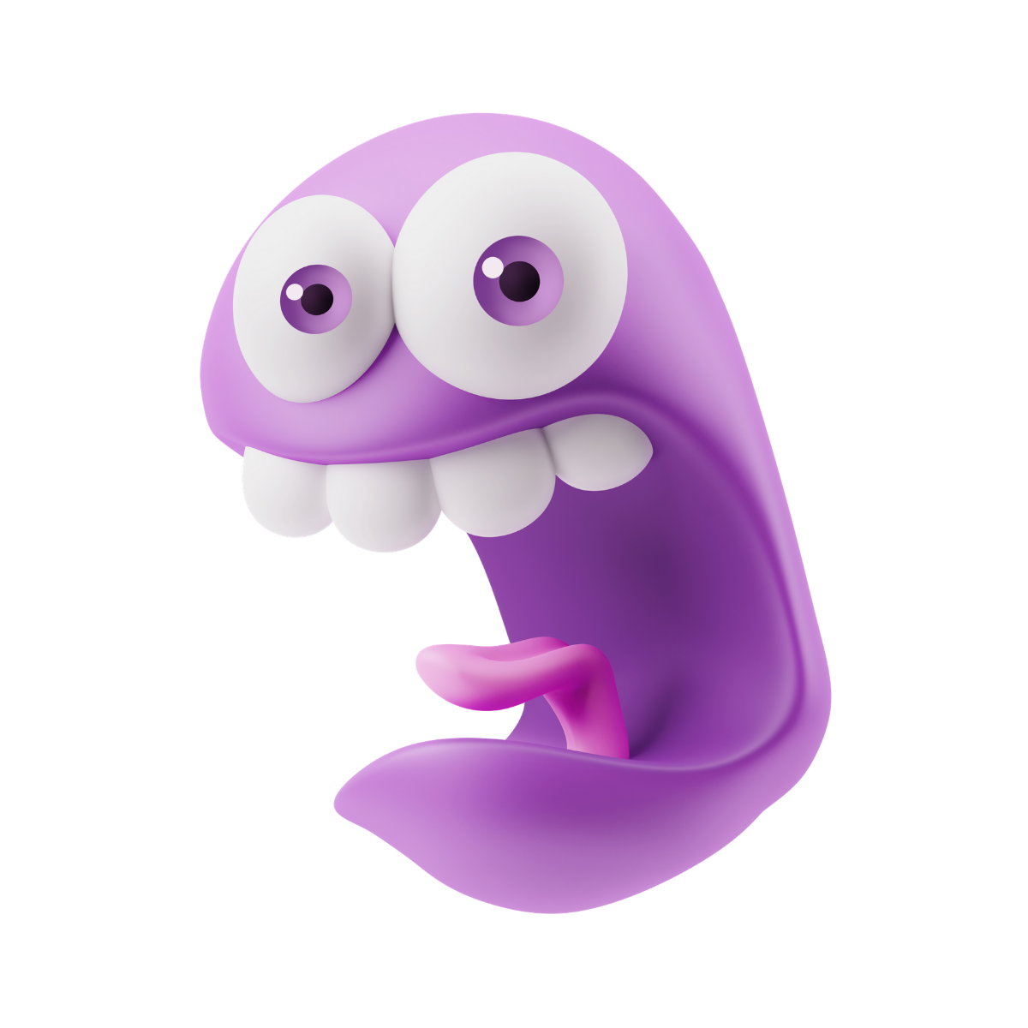
Welcome to the Look for the Good Charging Station!
Our friends at Look for the Good Project have helped us identify four challenging emotions that students may experience on Field Day:
Overly Excited
Worried
Frustrated
Embarrassed
Jittery & Scattered
Afraid & Jumpy
Angry & Disappointed
Want to Run & Hide
Think of these emotions as little friends who have come to visit.
Set up a Charging Station for students to make friends with these emotions and use their energy to get focused, motivated, courageous and resilient.
For more information, visit lookforthegoodproject.org.
The wiggles in this Charging Station have been Universally Designed to meet the needs of all students.
Notes:
Permission to Panic Book: https://www.amazon.com/dp/B08CWBFB6D

Slide 2

Welcome to the
LOOK FOR THE GOOD
Charging Station!
What Emotion Friend has come to visit? When emotions get large, it’s time to recharge.
Use our Wiggle Jars to help you recharge your batteries & transform your stress into strength!
The wiggles in this Charging Station have been Universally Designed to meet the needs of all students.
Notes:
Permission to Panic Book: https://www.amazon.com/dp/B08CWBFB6D

Slide 3
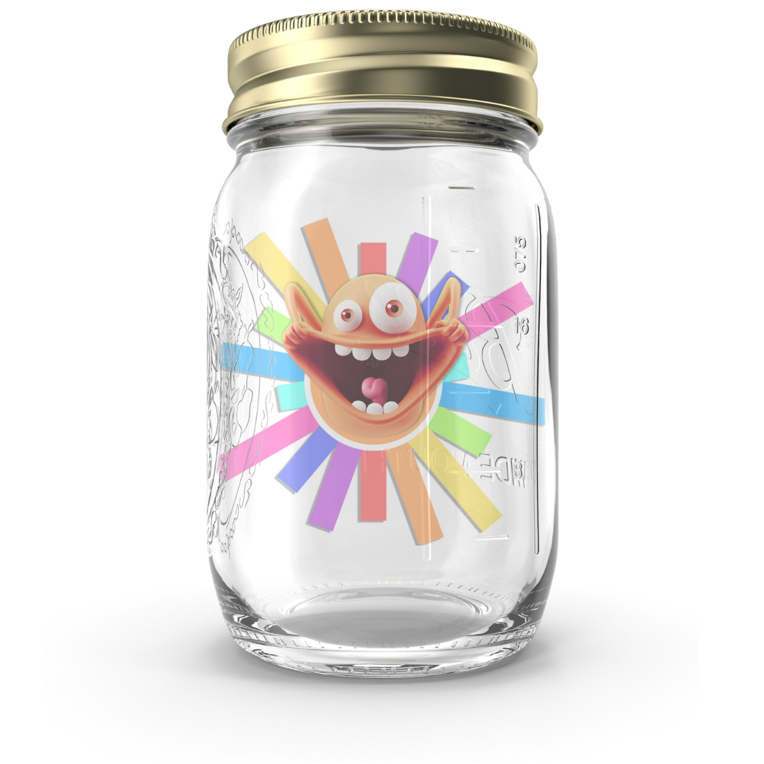

FEELING OVERLY EXCITED?
Sometimes we can feel too excited and it’s hard to control our behaviors.
You can turn your Excitement into Focus by performing physical activities from the Wiggle Jar! Let’s practice. Perform each activity for 30 seconds.
When finished, mark this event complete on your scorecard.
Perform all activities with a short rest in between each activity.
Bounce your body up and down.
Animal walks (e.g.,bear crawl, duck walk).
Move (e.g., dance, jog, march, wheel) in the space.
Give yourself a BIG HUG and twist/wiggle.
To finish, take slow, deep breaths.
Get 30-Second Interval Music on Apple Music or Spotify.
Congratulations!
You’ve started the process of turning your Excitement into Focus!
Notes:
Permission to Panic Book: https://www.amazon.com/dp/B08CWBFB6D

Slide 4

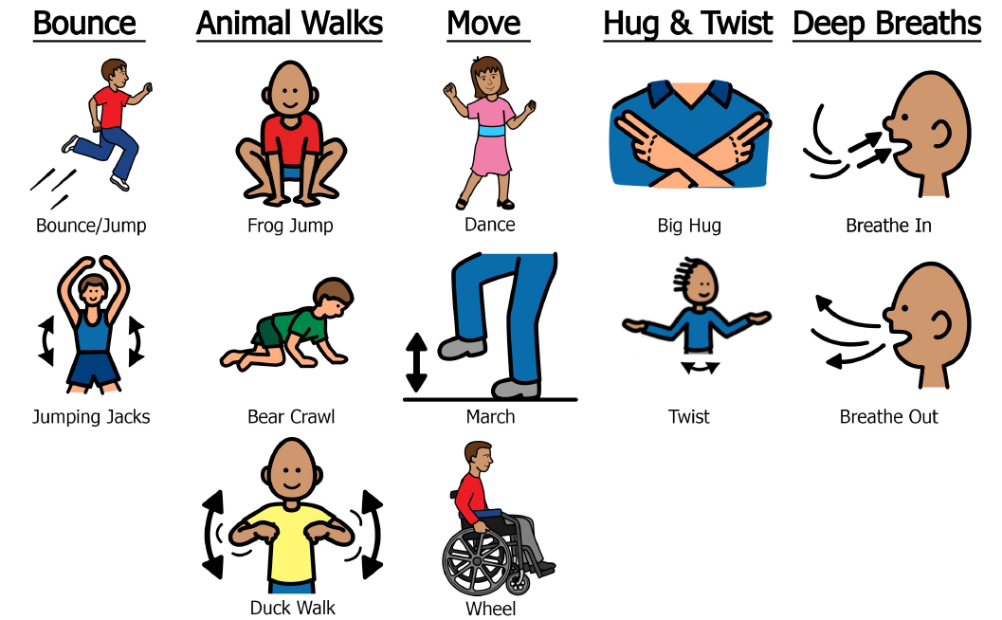
FEELING SUPER EXCITED?

Slide 5
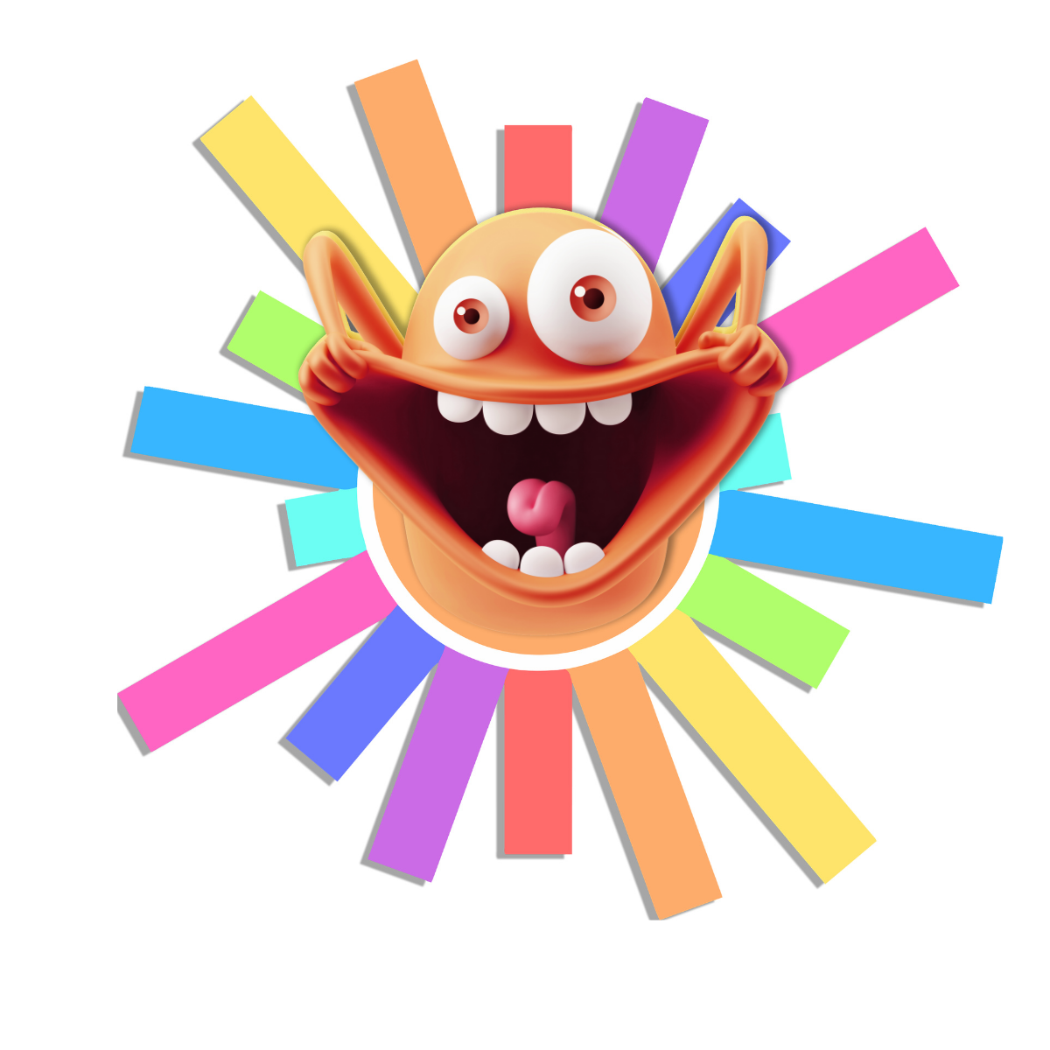
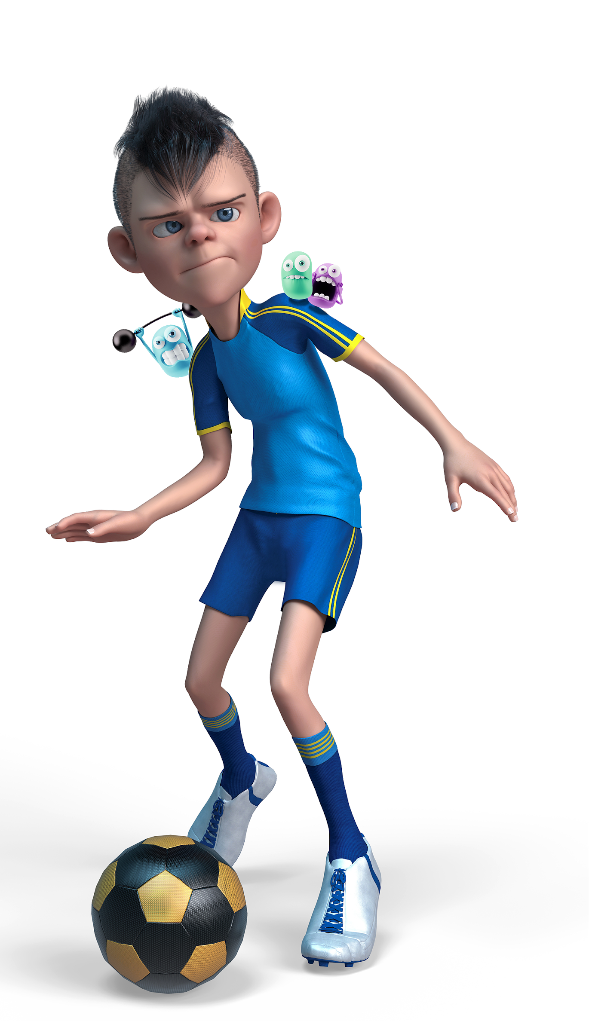
WIGGLE YOUR EXCITEMENT INTO FOCUS
Excitement arrives with a whoosh of energy that feels great! But if you don’t channel this energy into some sort of activity, all the excitement can add up and make you feel jittery and scattered. It’s kind of like when you eat too much sugar. Since this can make it hard to control behavior, too much excitement can be really challenging.
Here’s how you can channel your Excitement into Focus:
Do some of the wiggles from the Excited Wiggle Jar to move some of the energy through your body.
Once you are feeling calmer, take a deep breath.
Then ask yourself, “What am I excited about? Is there anything I am looking forward to? What is one thing I can do right now to make sure that happens?”
Create a goal and then channel all your excited energy into achieving this goal! You can do it!!
Notes:
Permission to Panic Book: https://www.amazon.com/dp/B08CWBFB6D

Slide 6
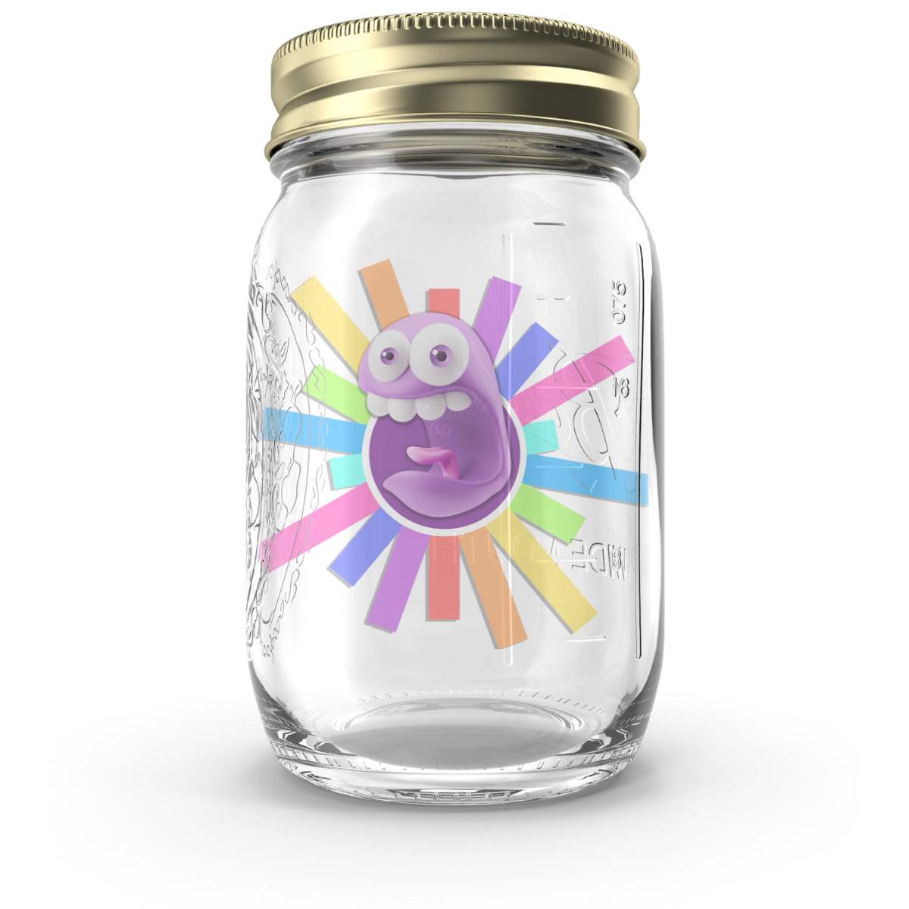

FEELING WORRIED?
Sometimes we want to participate but we’re worried we might not do things right. You can turn your Worry into Courage by performing physical activities from the Wiggle Jar! Let’s practice. Perform each activity for 30 seconds.
When finished, mark this event complete on your scorecard.
Perform all activities with a short rest in between each activity.
Make your body BIG and make your body SMALL.
Do windmill toe touches or trunk twists.
Stand tall like a giant pencil.
Give yourself a BIG HUG and twist & giggle.
To finish, take slow, deep breaths.
Get 30-Second Interval Music on Apple Music or Spotify.
Congratulations!
You’ve started the process of turning your Worry into Courage!
Notes:
Permission to Panic Book: https://www.amazon.com/dp/B08CWBFB6D

Slide 7
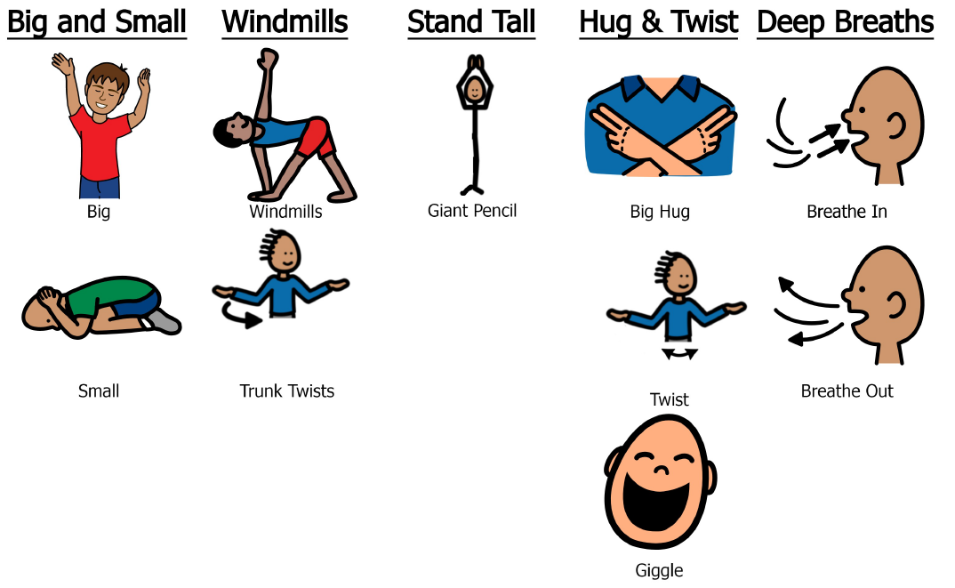
FEELING WORRIED?

Slide 8
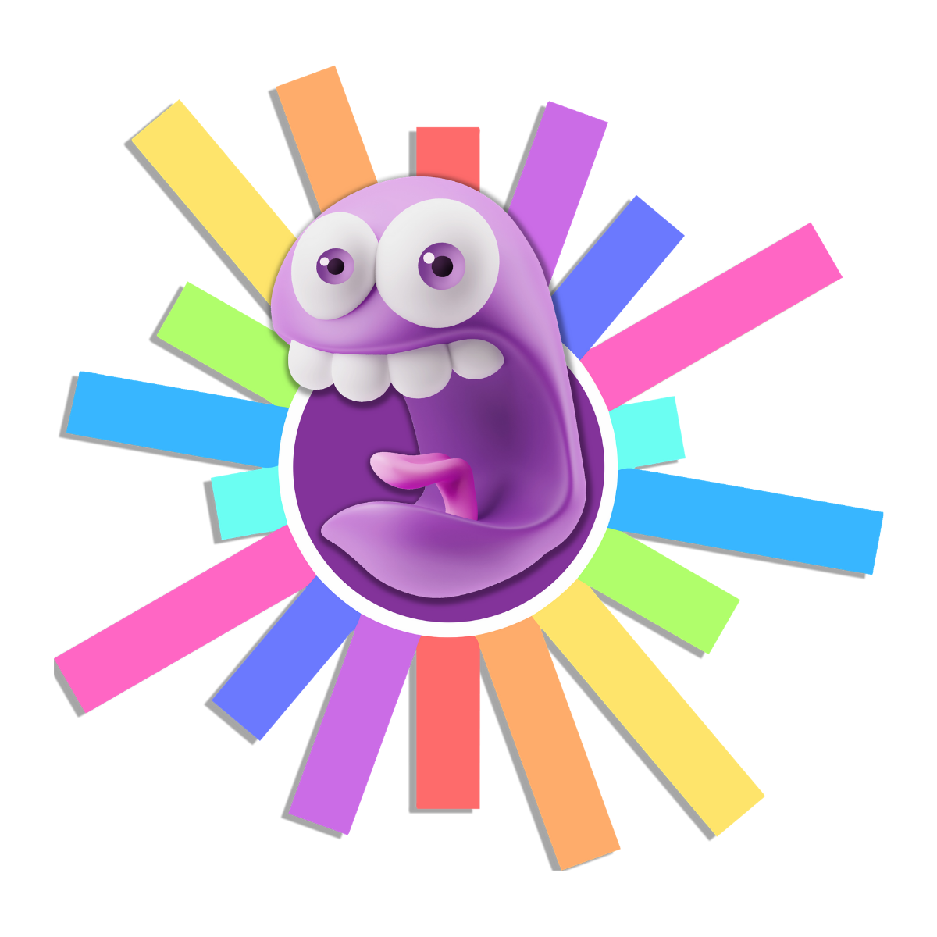
WIGGLE YOUR WORRY INTO COURAGE
Worry shows up when we need to pay attention. It helps us stay alert and get prepared. When we’re competing or playing a sport, it’s normal to feel worried.
Here’s how you can channel your Worry into Courage:
Do some of the wiggles from the Worried Wiggle Jar to move some of your stress energy out of your body.
Once you’re feeling calmer, take a deep breath.
Then ask yourself, “What am I worried about? Am I afraid to fail or make a mistake? Do I need more information on how to do an activity? Am I afraid to ask for help?”
It takes courage to try new things and to be open to making mistakes. Making mistakes is part of learning process. So is asking for help. Use the power of “Yet” to transform the worry of failing into the courage of trying: “I can’t do this YET, I’m not good at this YET, I don’t understand this YET.”
The only failure is not being willing to try.
Notes:
Permission to Panic Book: https://www.amazon.com/dp/B08CWBFB6D

Slide 9
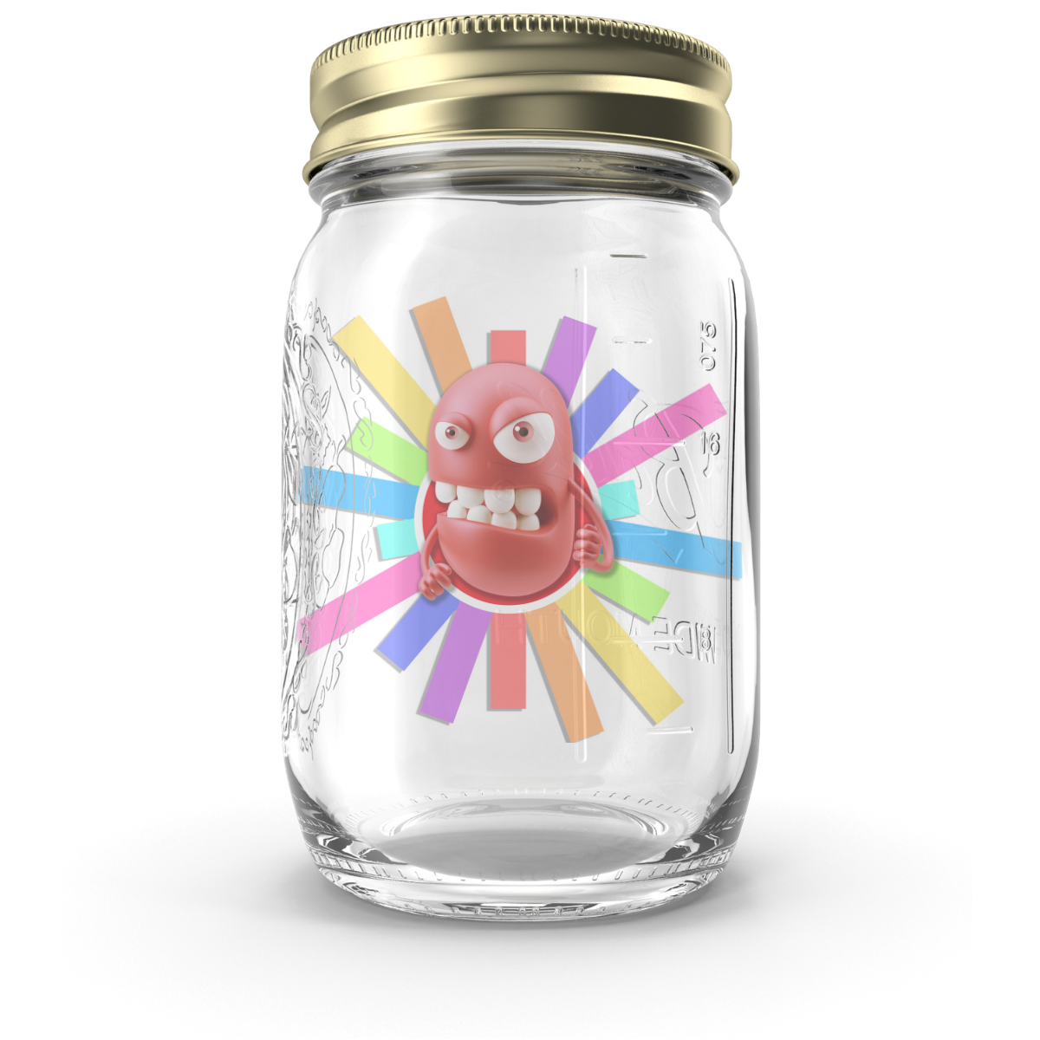

FEELING FRUSTRATED?
Sometimes we try really hard but things don’t turn out exactly the way we want. You can turn your Frustration into Motivation by performing physical activities from the Wiggle Jar! Let’s practice. Perform each activity for 30 seconds.
When finished, mark this event complete on your scorecard.
Perform all activities with a short rest in between each activity.
Stomp in place (feet or hands) and count.
Jump or reach as high as you can.
Fist pumps with gusto!
Give yourself a BIG HUG and twist & giggle.
To finish, take slow, deep breaths.
Get 30-Second Interval Music on Apple Music or Spotify.
Congratulations!
You’ve started the process of turning your Frustration into Motivation!
Notes:
Permission to Panic Book: https://www.amazon.com/dp/B08CWBFB6D

Slide 10
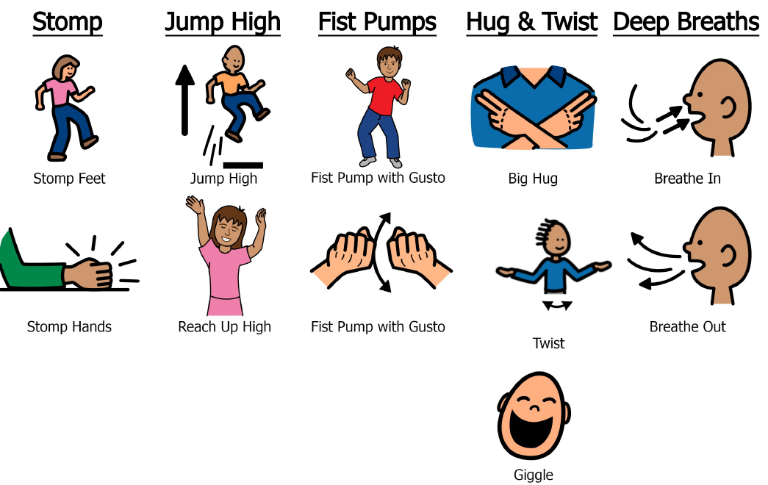
FEELING FRUSTRATED?
Notes:
Permission to Panic Book: https://www.amazon.com/dp/B08CWBFB6D

Slide 11
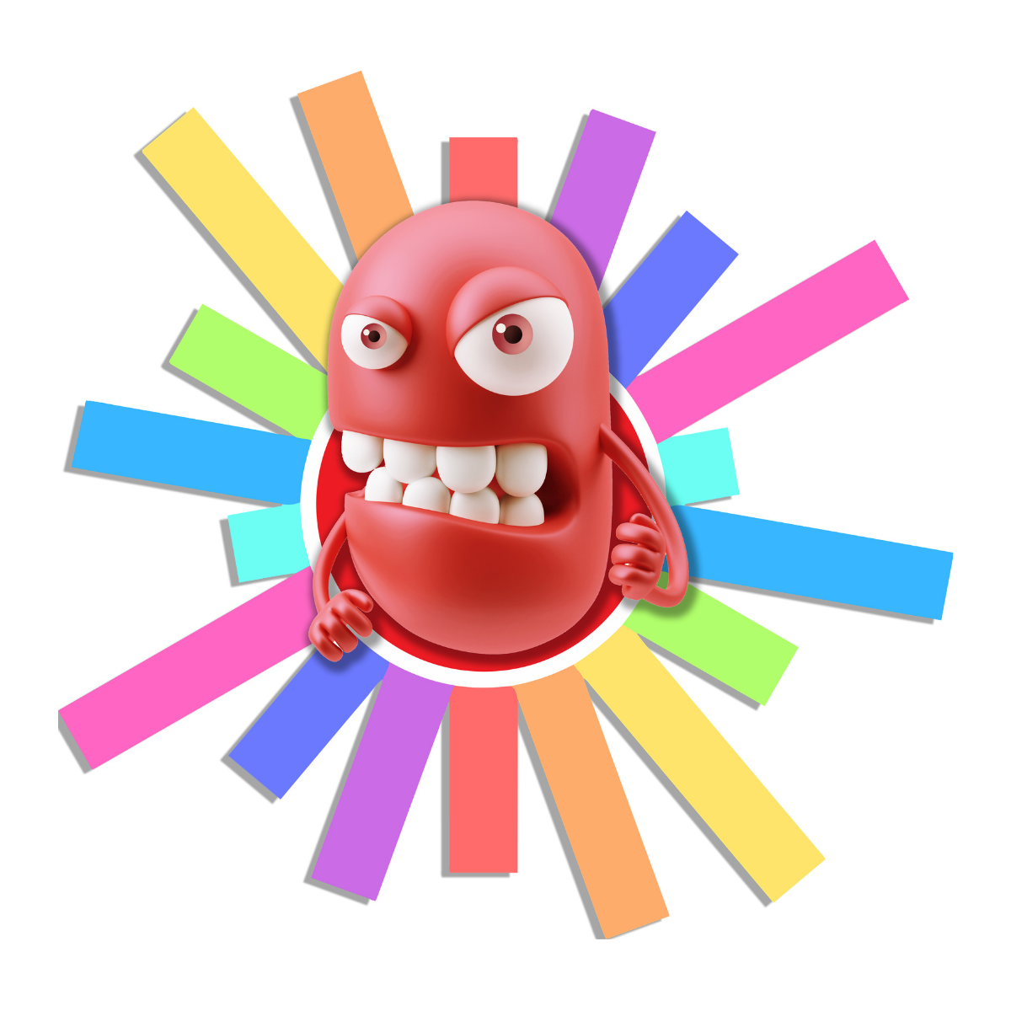
WIGGLE YOUR FRUSTRATION INTO MOTIVATION
Frustration shows up when we’re angry or disappointed about something. It helps us accept a loss or a change and creatively overcome an obstacle.
Here’s how you can channel your Frustration into Motivation:
Do some of the wiggles from the Frustrated Wiggle Jar to move the stress out of your body.
Once you’re feeling calmer, take a deep breath.
Then ask yourself, “What am I frustrated about? What did I want or hope for that didn’t happen? Was there anything I was looking forward to that changed or was much harder than I thought?”
Normally frustration shows up when an obstacle appears. At first we will try to fight against the obstacle and might even get mad or sad. But you can use your frustration to pivot into a new path. All you have to do is add your creativity. How can you look at this differently? Is there any way to get to the same goal using a different path? What’s still working that you can be grateful for?
Notes:
Permission to Panic Book: https://www.amazon.com/dp/B08CWBFB6D

Slide 12
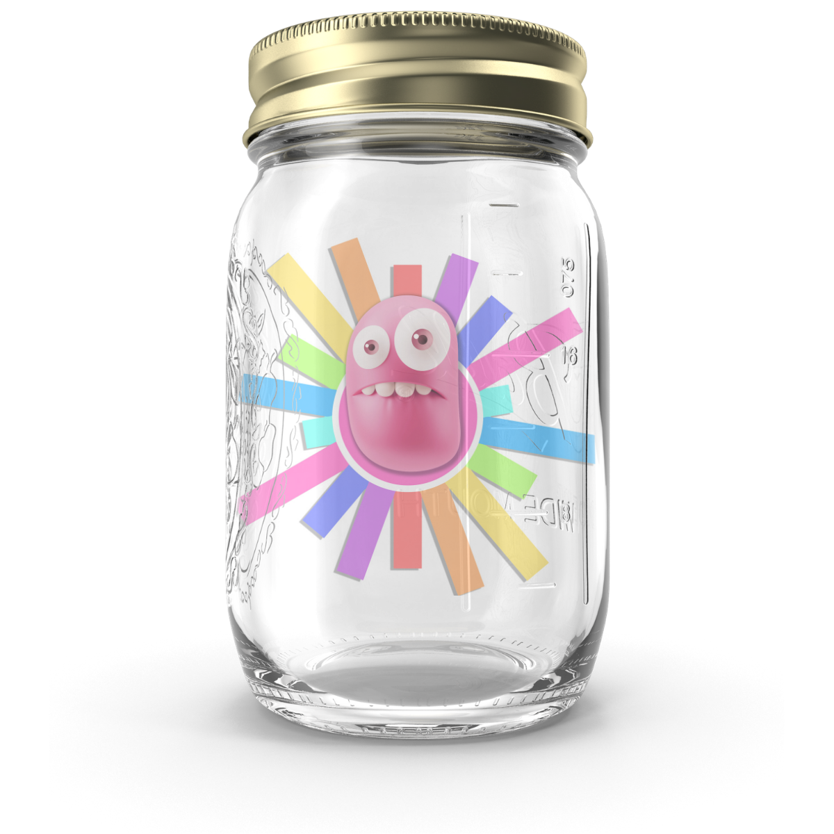

FEELING EMBARRASSED?
Sometimes we make mistakes while people are watching and we feel embarrassed. You can turn your Embarrassment into Resilience by performing physical activities from the Wiggle Jar! Let’s practice. Perform each activity for 30 seconds. When finished, mark this event complete on your scorecard.
Perform all activities with a short rest in between each activity.
Be silly while you move in place.
Swim your arms, make it FUN.
Stand STRONG like your favorite superhero.
Give yourself a BIG HUG and say…”I did it. I am brave.
I am smart. I am tough. I am awesome”.
To finish, take slow, deep breaths.
Get 30-Second Interval Music on Apple Music or Spotify.
Congratulations!
You’ve started the process of turning your Embarrassment into Resilience!
Notes:
Permission to Panic Book: https://www.amazon.com/dp/B08CWBFB6D

Slide 13
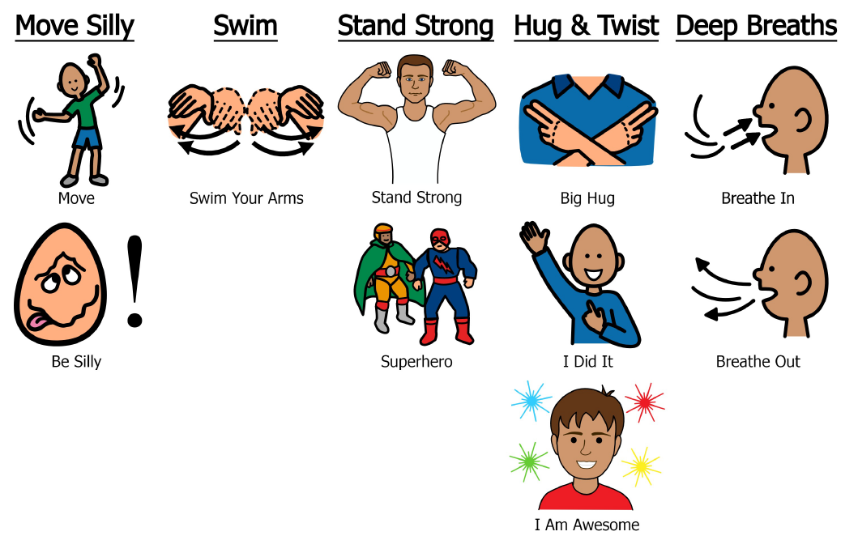
FEELING EMBARRASSED?
Notes:
Permission to Panic Book: https://www.amazon.com/dp/B08CWBFB6D

Slide 14
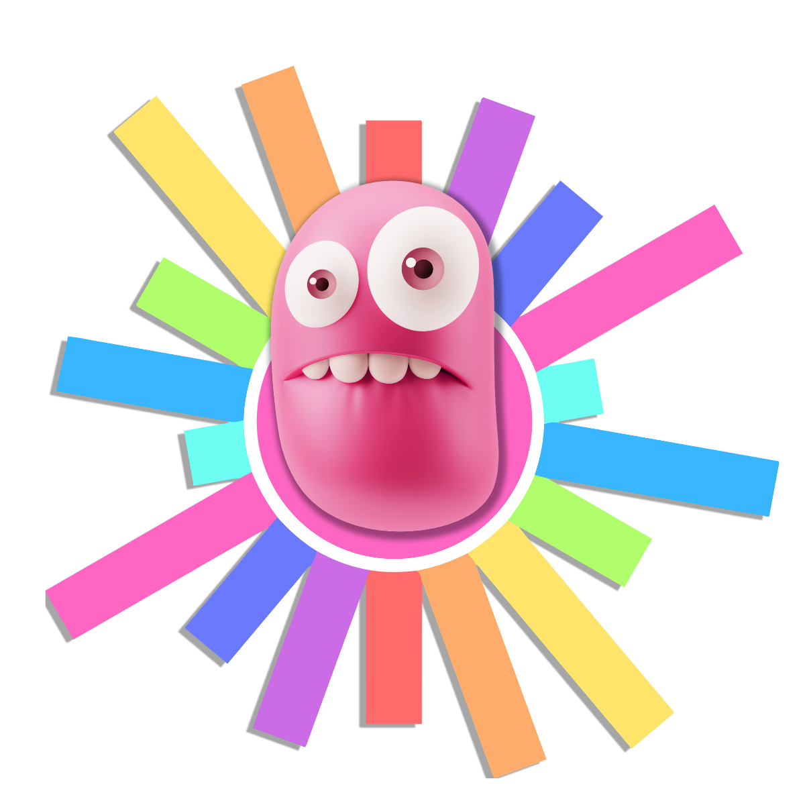
WIGGLE YOUR EMBARRASSMENT INTO RESILIENCE
Embarrassment shows up when we’re feeling like we’re not enough and don’t belong. It helps us learn how to accept ourselves, bounce back from disappointment, and be kind to others who might be feeling this too. Here’s how you can channel your Embarrassment into Resilience:
Do some of the wiggles from the Embarrassment Wiggle Jar to move the stress out of your body.
Take a deep breath and let it out slowly.
Then ask yourself, “What am I embarrassed about? Did I make a mistake or do something wrong? Am I afraid that I will be rejected by my friends and family?”
Even though you might have made a mistake, YOU are not a mistake. Mistakes are part of learning. Use your embarrassment to recognize where you need to repair a relationship, fix a mistake, or learn how to do something new. The strongest people are the ones who know how to admit to their mistakes and to apologize if needed. When you give yourself permission to fail, you accept yourself fully and give yourself a place to belong.
Notes:
Permission to Panic Book: https://www.amazon.com/dp/B08CWBFB6D

Slide 15
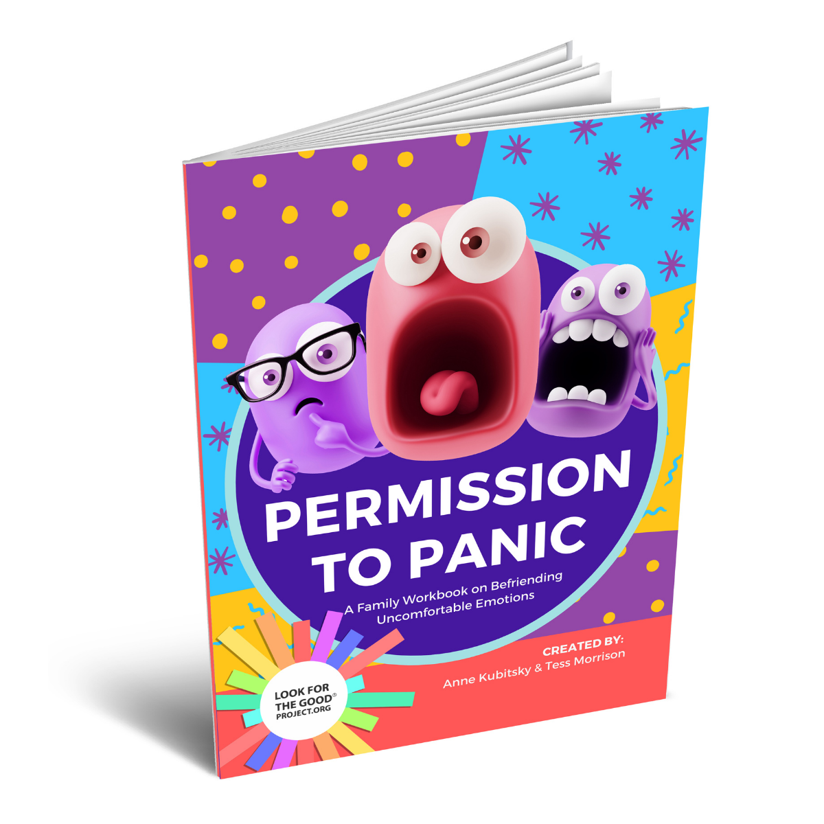
To learn more about all of your Emotion Friends, check out Look for the Good Project’s Family Workbook.
lookforthegoodproject.org
Notes:
Permission to Panic Book: https://www.amazon.com/dp/B08CWBFB6D

