Slide 1

KEEP IT UP
The Goal:
Strike or toss objects up as many times as possible. Beat your best score or the clock!
What You Need:
1–3 Lightweight objects (balloons, plastic bags, Scarves, or punch balls)
How To Play:
Clear a 10’ indoor or outdoor space. Start with 1, 2 or 3 lightweight objects.
Modify as needed based on individual needs.
Don’t let the object(s) hit the floor. If it does, pick the object(s) up and keep going.
On the start signal, strike objects upward. Count how many hits you can score.
If using multiple objects, alternate striking each object. Don’t strike the same object twice in a row.
UDL Mods:
Create a learning environment based on individual needs/abilities
Suspend a balloon on a string
Place objects on tray or table top
Use fan/blower to manipulate objects
Notes:
The Boardmaker family of products allows every student to succeed at their own pace, and on their unique path, with communication and literacy at the heart of it all. Learn more about Boardmaker online at www.goboardmaker.com.

Slide 2
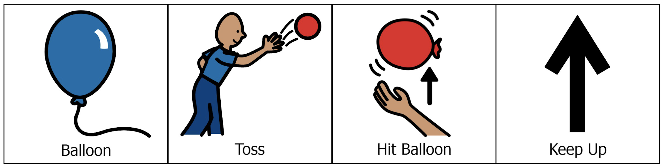
KEEP IT UP
Picture Communication Symbols® courtesy of Boardmaker 7.
Notes:
The Boardmaker family of products allows every student to succeed at their own pace, and on their unique path, with communication and literacy at the heart of it all. Learn more about Boardmaker online at www.goboardmaker.com.

Slide 3
SCAVENGER HUNT
The Goal:
Find as many items listed on the worksheet as possible.
What You Need:
Printed Copy of Scavenger Hunt Worksheet (modify based on students’ needs/abilities)
How To Play:
The items you have to find are things lying around your house, yard, or in a designated area.
On the start signal, search around your designated space and collect/mark the items that fit the description on the worksheet.
How quickly can you find all items on the worksheet?
UDL Mods:
Adapt visuals on scavenger hunt worksheet to match student needs / device.
Designated colors, shapes, toys can be varied.
Notes:
The Boardmaker family of products allows every student to succeed at their own pace, and on their unique path, with communication and literacy at the heart of it all. Learn more about Boardmaker online at www.goboardmaker.com.

Slide 4
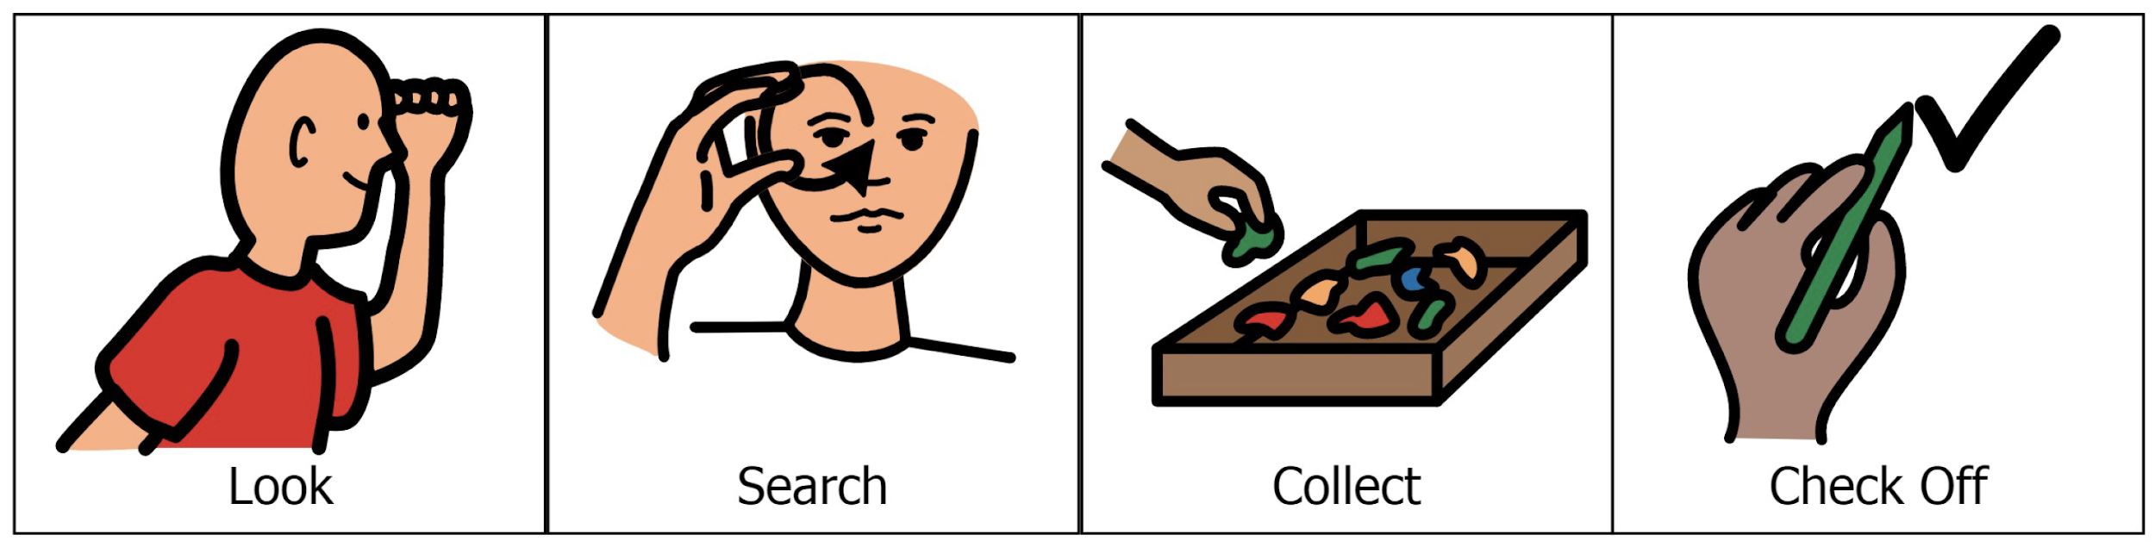
SCAVENGER HUNT
Picture Communication Symbols® courtesy of Boardmaker 7.
Notes:
The Boardmaker family of products allows every student to succeed at their own pace, and on their unique path, with communication and literacy at the heart of it all. Learn more about Boardmaker online at www.goboardmaker.com.

Slide 5
SPOON RELAY
The Goal:
Work with a partner to get all 5 objects to the finish line.
What You Need:
1 Carrying Implement, 1-5 Small Objects to Balance, Spot Markers for Start/End points
How To Play:
Create start and end points using spot markers.
Get ready with 1 object balanced on the implement.
On the start signal, carefully move from start to end with 1 object.
Drop off the object at the end point, return to start, and retrieve the next object.
If you drop an object, stop, place it back on the implement and continue the relay.
UDL Mods:
Use implements that meet student needs (like a spoon, short-handled racquet, tray, basket, or student hands.
Use objects that meet student needs (ball, marble, bean bag, etc.)
Shorten/lengthen travel distance as needed.
Notes:
The Boardmaker family of products allows every student to succeed at their own pace, and on their unique path, with communication and literacy at the heart of it all. Learn more about Boardmaker online at www.goboardmaker.com.

Slide 6
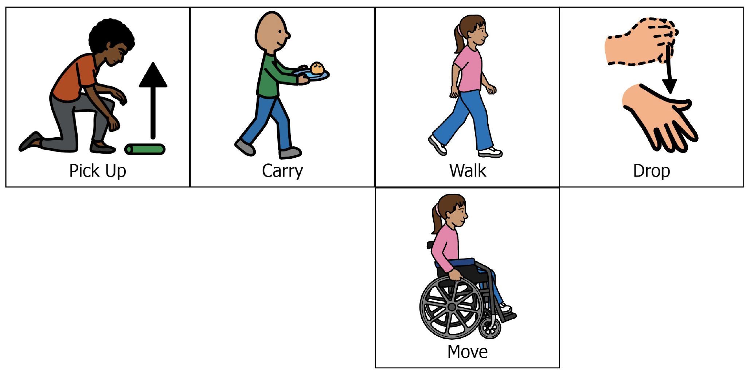
SPOON RELAY
Picture Communication Symbols® courtesy of Boardmaker 7.
Notes:
The Boardmaker family of products allows every student to succeed at their own pace, and on their unique path, with communication and literacy at the heart of it all. Learn more about Boardmaker online at www.goboardmaker.com.

Slide 7
WIND BOWLING
The Goal:
Knock all the cups off a table with a manipulative chosen to meet student ability needs.
What You Need:
10 Plastic Cups, 1 Object to Create Wind (paper plate, paddle, hair blower, or fan)
How To Play:
Set 10 empty cups, single file, at the edge of a table.
On the start signal, fan the plate or paddle aiming the wind toward the empty plastic cups.
Wave the paper plate like a fan with the wind hitting the cups, or aim a hair blower to meet student ability.
Score a point for every cup that gets knocked off the table in the time designated to meet individual needs
Student who makes at least 3 attempts to complete this event can mark it complete on the scorecard.
UDL Mods:
Adjust the number of cups (more or less) to challenge and meet student abilities.
Allow students to knock the cups off reaching with a hand or safe implement.
Notes:
The Boardmaker family of products allows every student to succeed at their own pace, and on their unique path, with communication and literacy at the heart of it all. Learn more about Boardmaker online at www.goboardmaker.com.

Slide 8
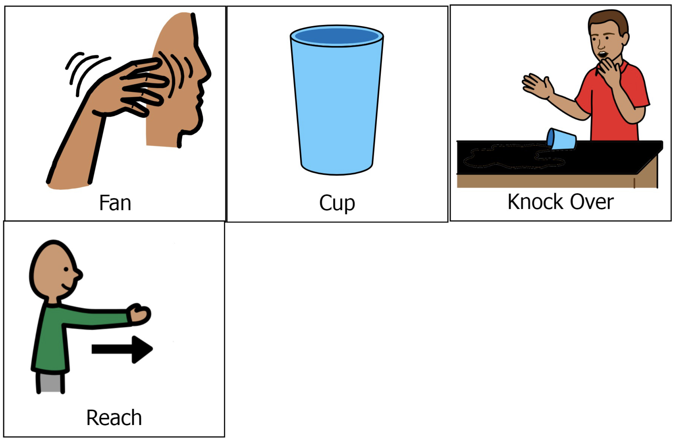
WIND BOWLING
Picture Communication Symbols® courtesy of Boardmaker 7.
Notes:
The Boardmaker family of products allows every student to succeed at their own pace, and on their unique path, with communication and literacy at the heart of it all. Learn more about Boardmaker online at www.goboardmaker.com.

Slide 9
BOWL BALL
The Goal:
To score as many points as you can in a set time by tossing the ball into the bowls.
What You Need:
6 Large Bowls (or targets of your choice), 1 Sock Ball (or tossable object of your choice)
How To Play:
Set bowls on the floor in a triangle 3”- 4” apart.
Mark the point total for each bowl with paper or tape in the bottom of each bowl. Mark a tossing line 6’-8’ away Hint: Big bowls are easier than small bowls!
On the start signal, begin tossing. After each toss, retrieve the sock and hustle back to toss again.
If the sock lands in a bowl, or crosses target area (based on needs), tally points with pen and paper.
On the stop signal, calculate your score. If you make at least 3 attempts to improve your score, mark the event complete on the scorecard.
UDL Mods:
Use hula hoops, jump rope or taped circles in place of bowls.
Use a light ball inside a sock, scarf or grocery bag.
Adapt shape, size, placement of targets as needed.
Use multiple tossing objects to prevent retrieval after a throw.
Allow students to throw, push, transfer or drop objects.
Notes:
The Boardmaker family of products allows every student to succeed at their own pace, and on their unique path, with communication and literacy at the heart of it all. Learn more about Boardmaker online at www.goboardmaker.com.

Slide 10
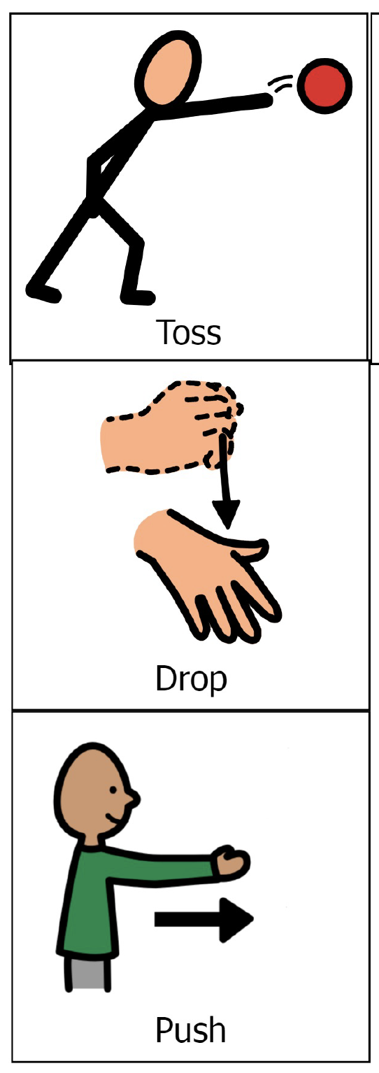
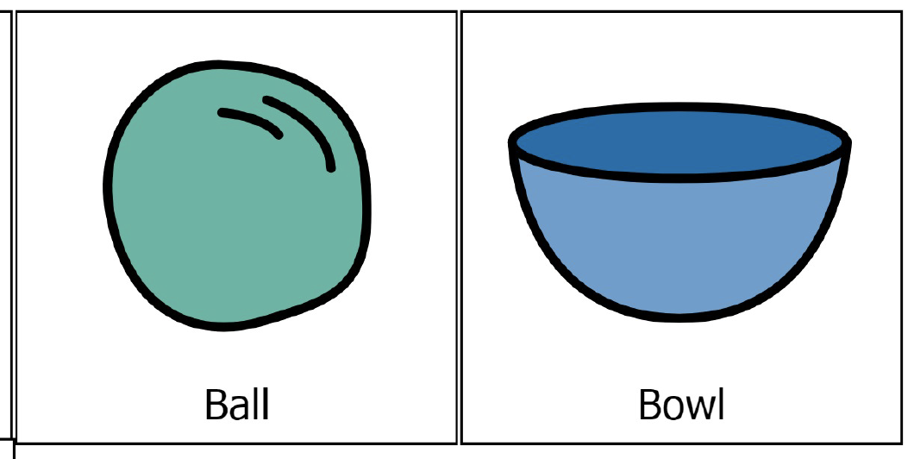
BOWL BALL
Picture Communication Symbols® courtesy of Boardmaker 7.
Notes:
The Boardmaker family of products allows every student to succeed at their own pace, and on their unique path, with communication and literacy at the heart of it all. Learn more about Boardmaker online at www.goboardmaker.com.

Slide 11
FLIP YOUR LID
The Goal:
The object is to flip your plastic lid upside down as many times as you can in a set time.
What You Need:
1 Kitchen Spatula, 1 Plastic Lid (from a jar or plastic container)
How To Play:
Place the lid facing up on a table or on the floor. Get your spatula ready!
On the start signal, slide your spatula under the lid and try to flip it into the air so that it lands upside down.
Earn a point for each successful flip. Total your points.
Quickly reset the lid after each flip.
If you make at least 3 attempts to improve your score, mark the event complete on the scorecard.
UDL Mods:
Change the spatula for a short handled paddle, kitchen strainer with handle, small sand shovel, or allow students to use hands.
Change the lid for a spot marker or flying disc.
Place lid on spatula for students before each flip.
Use stomp/smash pad to launch lid.
Notes:
The Boardmaker family of products allows every student to succeed at their own pace, and on their unique path, with communication and literacy at the heart of it all. Learn more about Boardmaker online at www.goboardmaker.com.

Slide 12
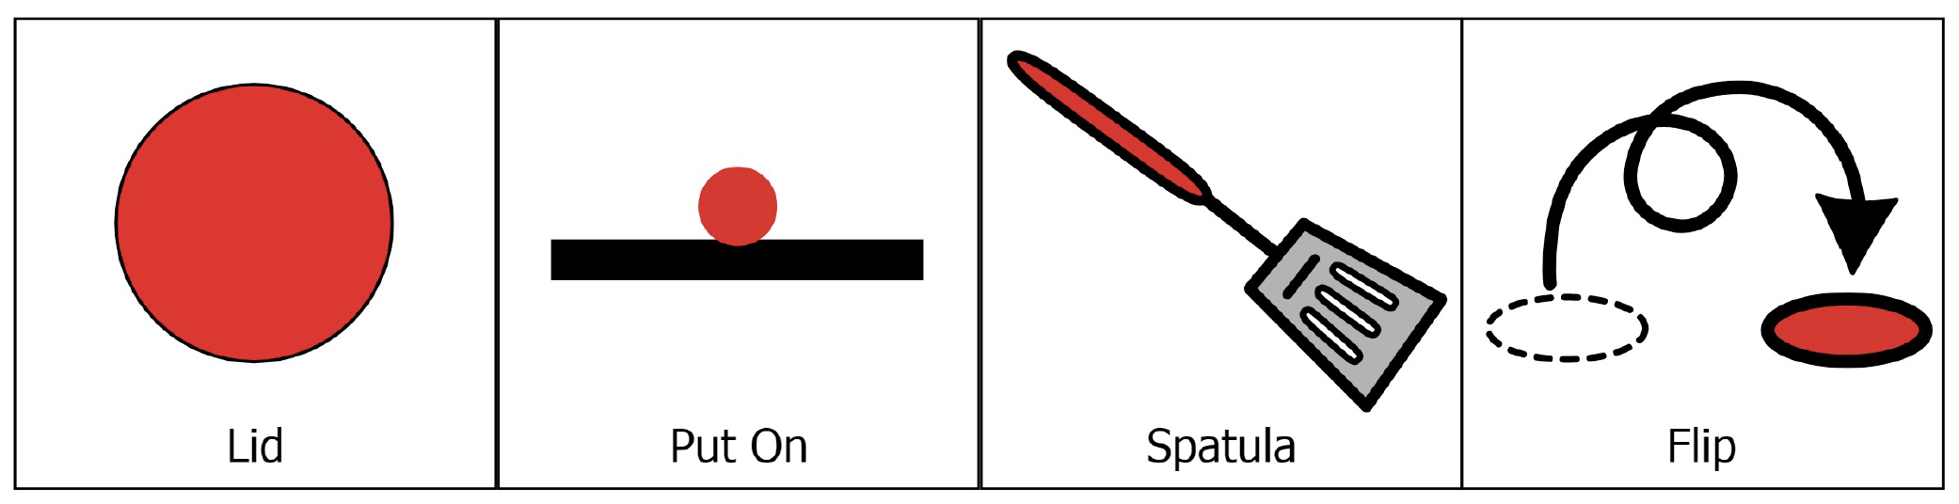
FLIP YOUR LID
Picture Communication Symbols® courtesy of Boardmaker 7.
Notes:
The Boardmaker family of products allows every student to succeed at their own pace, and on their unique path, with communication and literacy at the heart of it all. Learn more about Boardmaker online at www.goboardmaker.com.

Slide 13
FAN-A-WAR
The Goal:
Keep the object on your opponent’s side of the centerline until you hear the stop signal.
What You Need:
1 Paper Plate (cardboard, folder, or paddle) per player, Centerline (tape, string, or chalk),
1 ping pong ball (or other lightweight object)
How To Play:
Set a timer for 1 minute. On the start signal the timer begins.
Start fanning/moving the object toward your opponent’s side of the center line and away from your side. Score 5 points at the end of the 1-minute round if the object is on your opponent’s side.
Play 3 or 5 rounds. All players participating can mark this event complete on the scorecard.
UDL Mods:
Use pool noodle to push the ball (or other object - like a cup)
Change rules to meet needs (e.g. Place the object on a student tray/table).
Student pushes cup across line and then back as many times as possible in designated time.
Notes:
The Boardmaker family of products allows every student to succeed at their own pace, and on their unique path, with communication and literacy at the heart of it all. Learn more about Boardmaker online at www.goboardmaker.com.

Slide 14
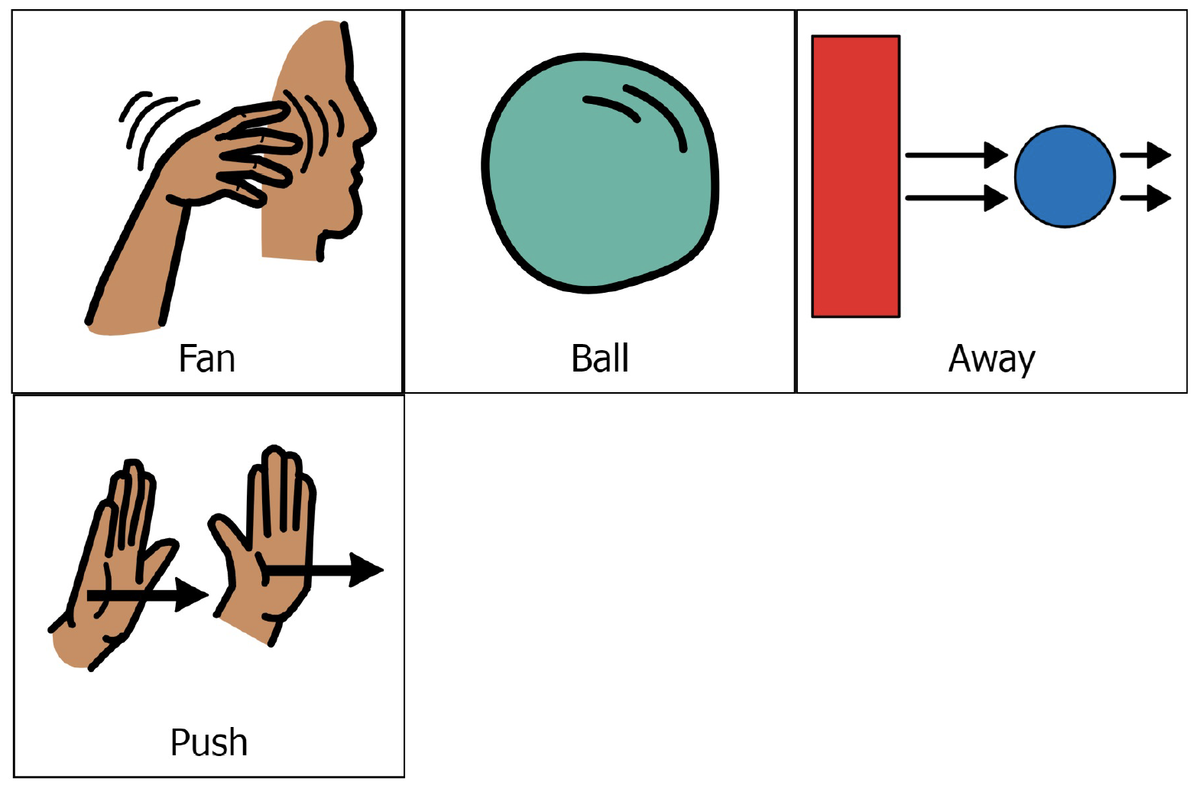
FAN-A-WAR
Picture Communication Symbols® courtesy of Boardmaker 7.
Notes:
The Boardmaker family of products allows every student to succeed at their own pace, and on their unique path, with communication and literacy at the heart of it all. Learn more about Boardmaker online at www.goboardmaker.com.

Slide 15
SOCK-ER SKEE-BALL
The Goal:
Score as many points as possible in 10 attempts by kicking sock balls into skee-ball targets.
What You Need:
Rolled Socks as Sock-balls, 3 Targets (large, medium, small – e.g. laundry baskets, bucket, large coffee can) stacked in Skee-ball Formation (on sides with opening facing players)
How To Play:
Start kicking sock balls into the targets.
Score 1 point for every sock in the large target, 5 points for the medium target, 10 points for the small target.
You get 10 chances to score as many points as possible.
If you complete all 10 attempts, mark the event complete on the scorecard.
UDL Mods:
Use targets of various sizes to match students’ needs.
Rather than kicking, students can place, throw, roll, toss, drop, or push balls into the containers.
Notes:
The Boardmaker family of products allows every student to succeed at their own pace, and on their unique path, with communication and literacy at the heart of it all. Learn more about Boardmaker online at www.goboardmaker.com.

Slide 16
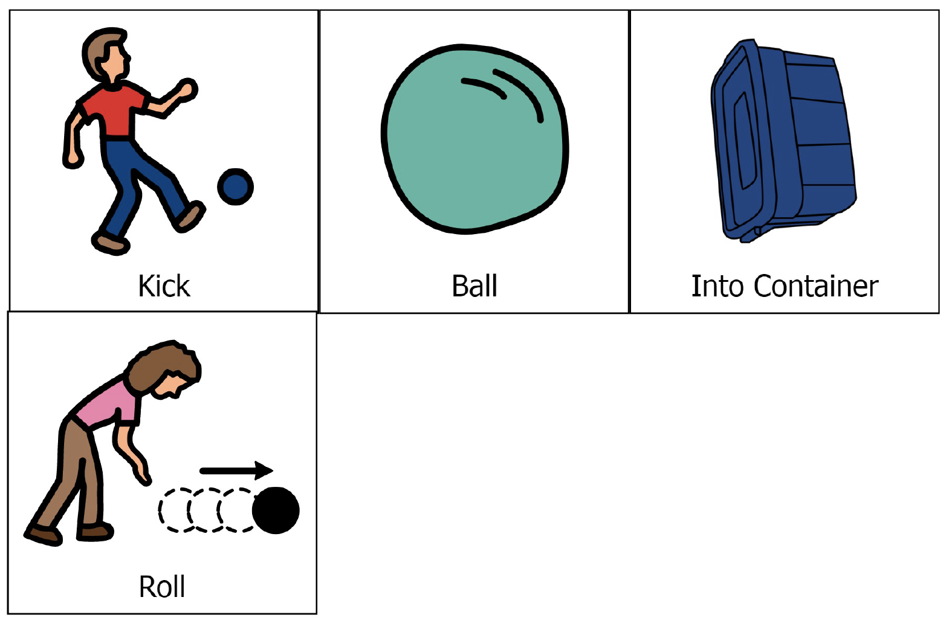
SOCK-ER SKEE-BALL
Picture Communication Symbols® courtesy of Boardmaker 7.
Notes:
The Boardmaker family of products allows every student to succeed at their own pace, and on their unique path, with communication and literacy at the heart of it all. Learn more about Boardmaker online at www.goboardmaker.com.

Slide 17
WATER BOTTLE TRAP
The Goal:
Score as many points as possible in 1 minute (or another designated time)..
What You Need:
1 Empty Water Bottle (or bucket), 1 Laundry Basket (or large container), 1 Sock/Tennis Ball
How To Play:
Lean the edge of a laundry basket on top of an empty water bottle. Mark a rolling line 8’-10’ away (the open side of the basket should face you).
Roll ball at the water bottle. To score the ball must hit the bottle. (Rolls that hit the basket first don’t count!)
Score 1 point = basket falls and traps ball only
Score 2 points = basket falls and traps bottle only
Score 3 points = basket falls and traps both!
UDL Mods:
Students can kick or push the ball instead of rolling.
Attach a string to the bottle or bucket and have the student pull the string until the bottle tips and basket falls off.
Notes:
The Boardmaker family of products allows every student to succeed at their own pace, and on their unique path, with communication and literacy at the heart of it all. Learn more about Boardmaker online at www.goboardmaker.com.

Slide 18
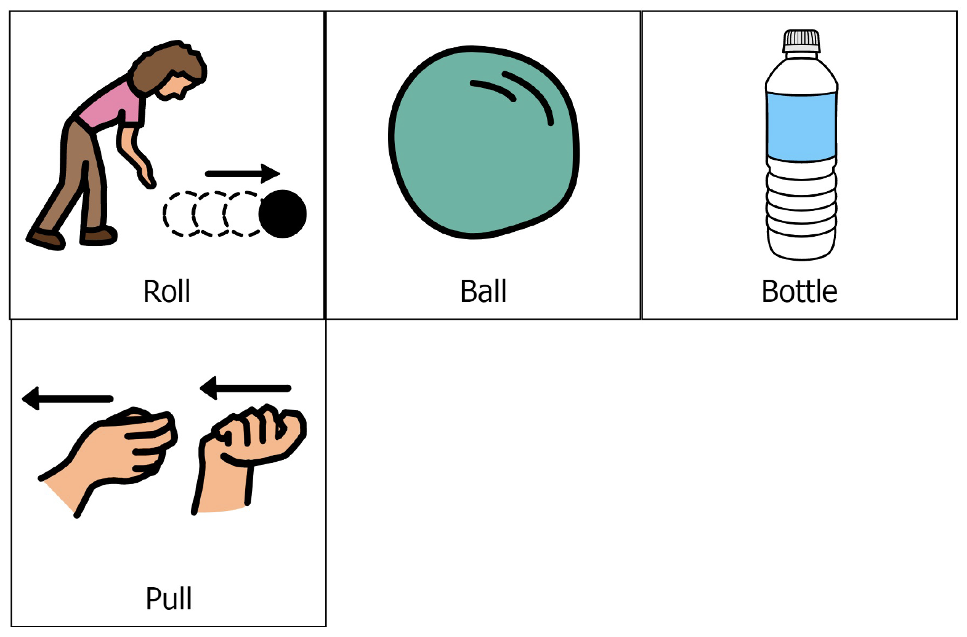
WATER BOTTLE TRAP
Picture Communication Symbols® courtesy of Boardmaker 7.
Notes:
The Boardmaker family of products allows every student to succeed at their own pace, and on their unique path, with communication and literacy at the heart of it all. Learn more about Boardmaker online at www.goboardmaker.com.

Slide 19
PENGUIN RACE
The Goal:
Score as many points as possible in 1 minute (or another designated time) by walking like a penguin and flipping over the cups.
What You Need:
1 Sock or Tennis Ball and 2 Plastic Cups per Player.
How To Play:
Race the clock or another penguin.
Place and hold the egg (ball) between your knees.
On the start signal, waddle back and forth from one cup to the other. When you reach the cup, turn it over.
Score 1 point every time that you flip a cup.
If you drop the egg, do 5 jumping jacks (or other exercise) before continuing.
Partner-Race-Challenge! Be the first to turn 6 cups.
UDL Mods:
Place the egg on any body part and move from one cup to the other.
Place cups on higher surface.
Notes:
The Boardmaker family of products allows every student to succeed at their own pace, and on their unique path, with communication and literacy at the heart of it all. Learn more about Boardmaker online at www.goboardmaker.com.

Slide 20
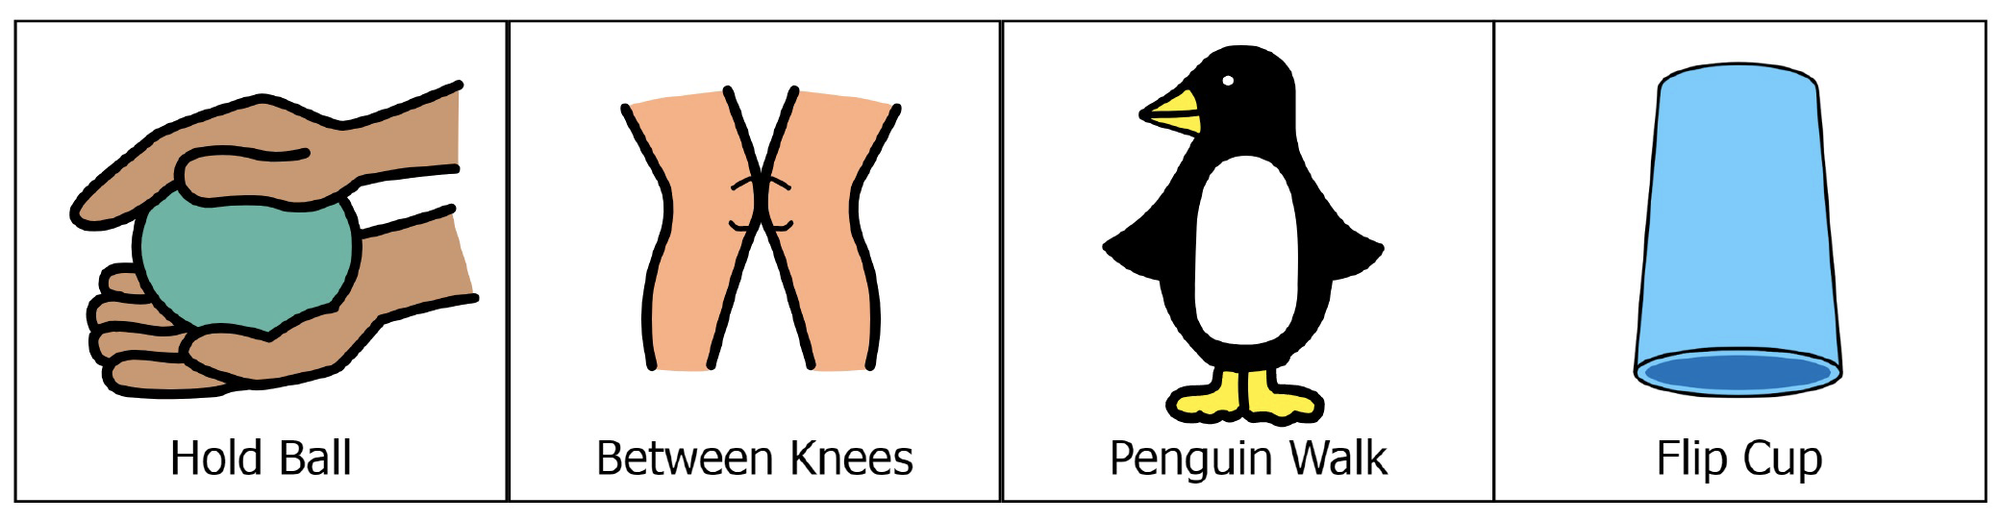
PENGUIN RACE
Picture Communication Symbols® courtesy of Boardmaker 7.
Notes:
The Boardmaker family of products allows every student to succeed at their own pace, and on their unique path, with communication and literacy at the heart of it all. Learn more about Boardmaker online at www.goboardmaker.com.

Slide 21
BACKBOARD BANK IT
The Goal:
Score as many points as possible in 1 minute (or another designated time) by tossing sock balls off of the wall and into the basket.
What You Need:
5 Sock Balls (paper or foam ball or any soft ball available), Laundry Basket or Bucket, Wall
How To Play:
Place a basket or bucket against a wall. Mark a distance 5’-10’ from the basket.
On the start signal start tossing the sock balls into the basket. You MUST bounce the ball off of the wall for the point to be counted.
Score 1 point for every sock that is banked into the basket.
UDL Mods:
Allow students to choose a ball based on preference/skill.
Modify the distance between the tossing spot and the basket to increase success.
Allow all baskets to count as a point, even those not banked.
Notes:
The Boardmaker family of products allows every student to succeed at their own pace, and on their unique path, with communication and literacy at the heart of it all. Learn more about Boardmaker online at www.goboardmaker.com.

Slide 22
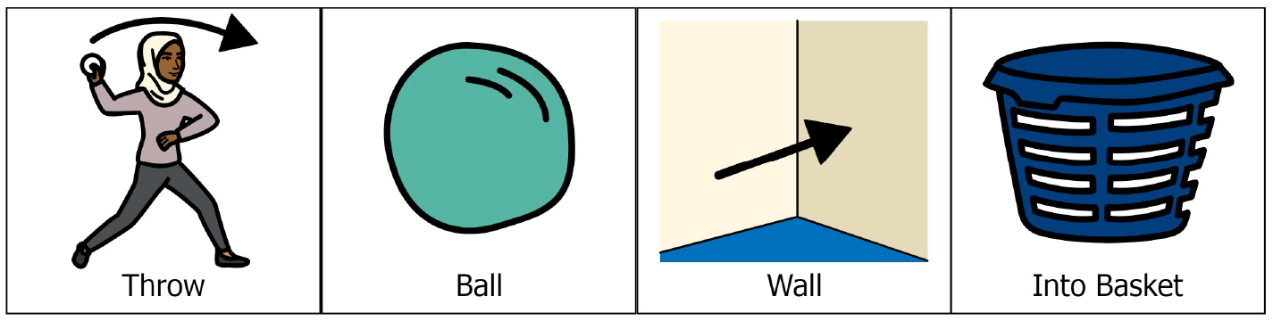
BACKBOARD BANK IT
Picture Communication Symbols® courtesy of Boardmaker 7.
Notes:
The Boardmaker family of products allows every student to succeed at their own pace, and on their unique path, with communication and literacy at the heart of it all. Learn more about Boardmaker online at www.goboardmaker.com.

Slide 23
PAPER PLANE CORN HOLE
The Goal:
Score as many points as possible in 1 minute (or another designated time) by throwing your paper object (like a plane) into the target (bucket or hoop).
What You Need:
3 Sheets of Paper per Player, a Target (bucket, hoop, laundry basket)
How To Play:
Place a basket or bucket against a wall. Mark a distance 5’-15’ from the basket. Create paper objects.
On the start signal, toss paper objects to the target.
When all 3 objects have been tossed, hurry to collect them and then keep tossing until time runs out.
Score 1 point for every object that hits the outside of the target, and 2 points for every object that lands inside the target.
UDL Mods:
Paper planes and paper balls are both example of paper objects to be thrown. You can also use beanbags to promote success.
Modify the distance between the tossing spot and the target to increase success.
Notes:
The Boardmaker family of products allows every student to succeed at their own pace, and on their unique path, with communication and literacy at the heart of it all. Learn more about Boardmaker online at www.goboardmaker.com.

Slide 24
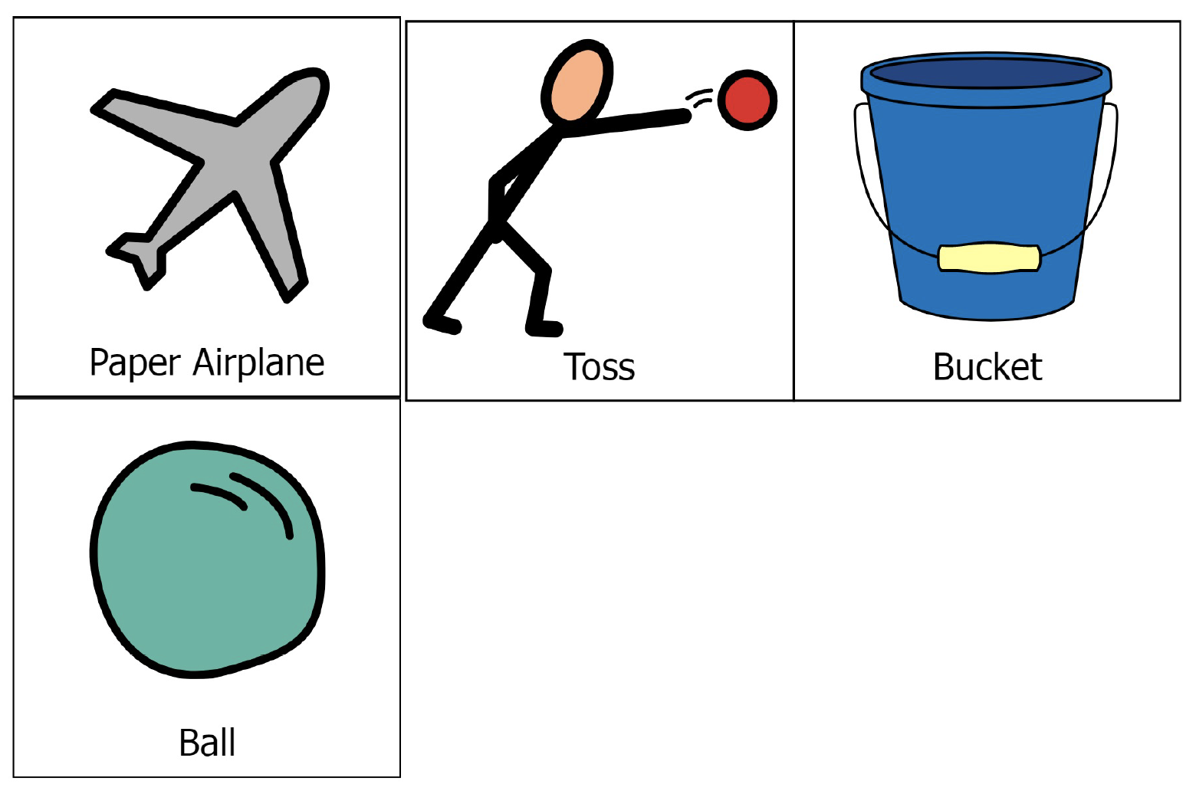
PAPER PLANE CORN HOLE
Picture Communication Symbols® courtesy of Boardmaker 7.
Notes:
The Boardmaker family of products allows every student to succeed at their own pace, and on their unique path, with communication and literacy at the heart of it all. Learn more about Boardmaker online at www.goboardmaker.com.

Slide 25
TENNIS SHOE TOWER
The Goal:
Build a shoe tower as high as you can with the shoes collected from the pile.
What You Need:
5-15 Shoes per Player, 1 Spot Marker per Player to Create a Home Base (e.g., paper plates)
How To Play:
Create a shoe pile with all of the collected shoes at one side of the activity area. Place home base spots equal distance from the pile.
On the start signal, move and take 1 shoe from the pile. Then, return to home base and begin building. Move back and forth, collecting and building.
If the tower falls, that’s okay, rebuild and keep going.
When the shoes are gone, count and score 1 point for every shoe in the tower.
UDL Mods:
Pile and/or build with shoes on a higher surface.
Use flat shoes (e.g. flip flops)
Use stuffed toys in place of shoes.
Use blocks or some other easily stackable objects.
Notes:
The Boardmaker family of products allows every student to succeed at their own pace, and on their unique path, with communication and literacy at the heart of it all. Learn more about Boardmaker online at www.goboardmaker.com.

Slide 26
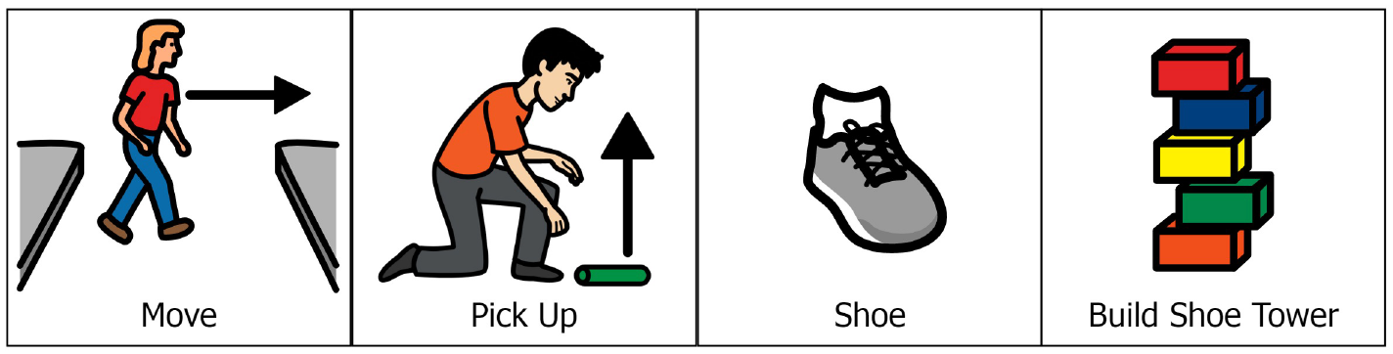
TENNIS SHOE TOWER
Picture Communication Symbols® courtesy of Boardmaker 7.
Notes:
The Boardmaker family of products allows every student to succeed at their own pace, and on their unique path, with communication and literacy at the heart of it all. Learn more about Boardmaker online at www.goboardmaker.com.

Slide 27
MILK JUG RELAY
The Goal:
Move the objects (i.e. milk jugs) back and forth as many times as you can in 1 minute (or another designated time).
What You Need:
2 1-Gallon Milk Jugs per Player, Spot Markers to Mark Start/Finish Lines, Timer
How To Play:
Create start and end lines using spot markers. Lines can be 15-30 steps apart, or 10 pushes if you use a wheelchair.
Fill 2 1-gallon jugs with water (¼, ½, or full) and place at the start line.
On the signal, carry the object (or objects) across the room and back as many times as you can.
Score 1 point for each full length traveled in 1 minute.
UDL Mods:
Use a variety of objects and allow students to choose (e.g., soup cans, water bottles, grocery bags with objects inside.)
Carry objects in your lap if you’re pushing your wheelchair.
Notes:
The Boardmaker family of products allows every student to succeed at their own pace, and on their unique path, with communication and literacy at the heart of it all. Learn more about Boardmaker online at www.goboardmaker.com.

Slide 28
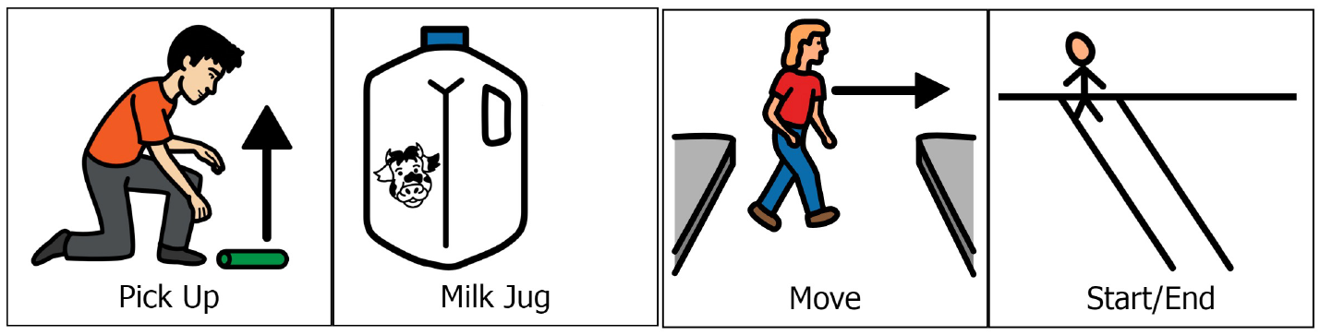
MILK JUG RELAY
Picture Communication Symbols® courtesy of Boardmaker 7.
Notes:
The Boardmaker family of products allows every student to succeed at their own pace, and on their unique path, with communication and literacy at the heart of it all. Learn more about Boardmaker online at www.goboardmaker.com.

Slide 29
LOOK FOR THE GOOD
The Goal:
Score points by finding 4 objects in your house (1 at a time) that fit in the Look for the Good category of your choice.
What You Need:
Spot Marker to Mark a Home Base
How To Play:
Choose a Look for the Good category from the following list: 4 of your favorite objects; 4 objects that match your favorite color; 4 objects that start with L,F,T,G Look For The Good.
On the start signal, move through your house and find the first object in the Look for the Good category.
Bring the object back to Home Base and then go find the second object.
Continue until all 4 objects are back at Home Base.
UDL Mods:
Provide each player with the names of the actual objects (L, F, T, G) to be found.
Plan ahead and create visual pictures of the objects that students can search and find.
Choose 4 objects that make different sounds. Students search for the sounds.
Notes:
The Boardmaker family of products allows every student to succeed at their own pace, and on their unique path, with communication and literacy at the heart of it all. Learn more about Boardmaker online at www.goboardmaker.com.

Slide 30
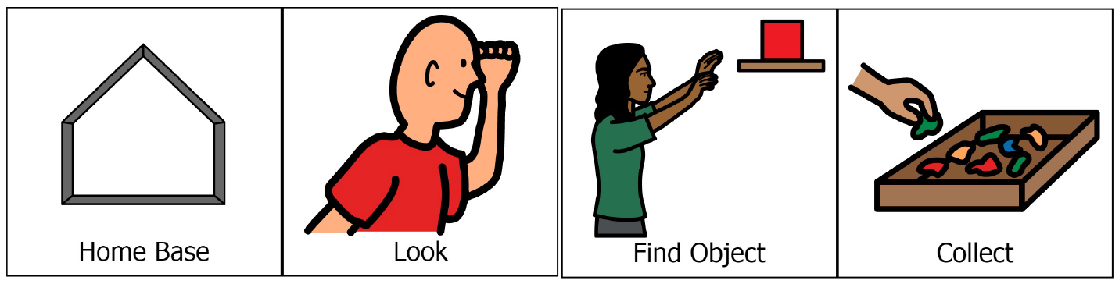
LOOK FOR THE GOOD
Picture Communication Symbols® courtesy of Boardmaker 7.
Notes:
The Boardmaker family of products allows every student to succeed at their own pace, and on their unique path, with communication and literacy at the heart of it all. Learn more about Boardmaker online at www.goboardmaker.com.

