Slide 1
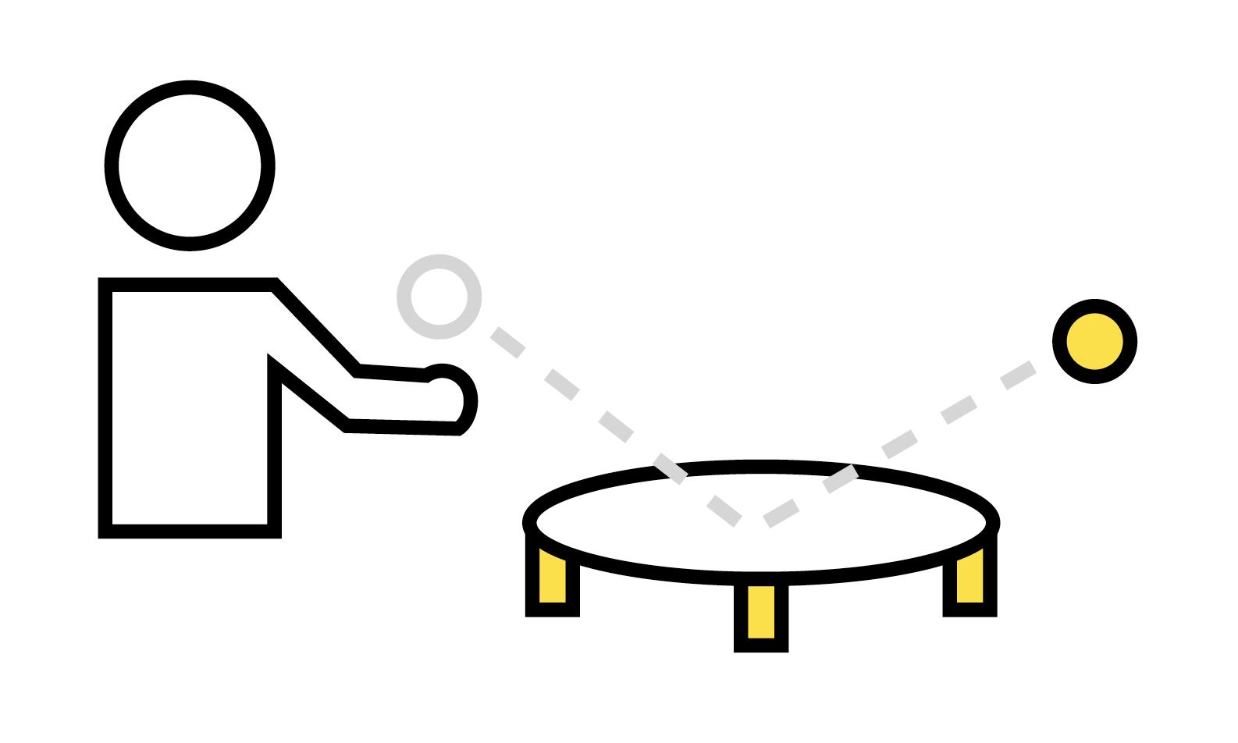
Our Spikeball National Field Day Challenges are adapted from Spikeball’s FREE 10-day PE curriculum.
[Download it Here]
Tips from our friends at Spikeball
Athletic position
Hand facing up toward sky/ceiling
Keep your hand flat
Keep your hand soft
Keep your eye on the ball
Common modifications to make activities easier...
Catch the ball before passing
Throw the ball instead of passing
Let the ball bounce once per touch
Use a bigger/lighter ball
Use a bigger Spikeball™ Set or target
More than 3 or unlimited touches
Learn more at Spikeball.com
Notes:
NK

Slide 2

Passing
(Individual Challenges)
The Goal:
How many self-passes can you make in a row?
What You Need:
A Spikeball™ or another ball that you can pass and strike like a Spikeball™
How To Play:
Level 1 - Use only underhand passes
Level 2 - Use only overhand passes
Level 3 - Use both overhand and underhand passes
Level 4 - Use only underhand passes and your non-dominant hand
Level 5 - Use either overhand and underhand passes while alternating hands
Level 6 - Use both overhand and underhand passes while jogging
Level 7 - Use only overhand passes and your non-dominant hand
Notes:
NK

Slide 3
Passing
(Partner Challenges)
The Goal:
How many partner passes can you make in a row?
What You Need:
A Spikeball™ or another ball that you can pass and strike like a Spikeball™
How To Play:
Level 1 - Use both overhand and underhand passes
Level 2 - Use only underhand passes
Level 3 - Use only overhand passes
Level 4 - Use any pass to pass to yourself before passing to your partner
Level 5 - Use only underhand passes and your non-dominant hand
Level 6 - Partner A uses underhand passes, Partner B uses overhand passes
Level 7 - Same as level 6, but Partner A and Partner B switch roles
Notes:
CY

Slide 4
Hitting to the Net
(Individual Challenges)
The Goal:
Complete as many levels as you can.
Silver Medal = 3 hits in a row on target Gold Medal = 5 hits in a row on target
What You Need:
A Spikeball™ (or similar ball) and Spikeball™ Net (or hula hoop)
How To Play:
Level 1 - Stand next to the net. Self-toss and hit the ball onto the net
Level 2 - Stand 1’ from the net. Self-toss and hit the ball onto the net
Level 3 - Stand 3’ from the net. Self-toss and hit the ball onto the net
Level 4 - Stand 5’ from the net. Self-toss and hit the ball onto the net
Level 5 - Stand 5’ from the net. Self-toss the ball towards the net and hit while moving
Level 6 - Stand 1’ from the net. Self-toss and hit onto the net using non-dominant hand
Level 7 - Stand 3’ from the net. Self-toss and hit onto the net using non-dominant hand
Level 8 - Stand 5’ from the net. Self-toss and hit onto the net using non-dominant hand
Level 9 - 5’ from the net. Self-toss towards the net. Hit while moving w/non-dominant hand
Notes:
BD- I changed it slightly (hope that’s OK)

Slide 5
Hitting to the Net
(Partner Challenges)
The Goal:
Complete as many levels as you can.
Silver Medal = 3 hits in a row on target Gold Medal = 5 hits in a row on target
What You Need:
A Spikeball™ (or similar ball) and Spikeball™ Net (or hula hoop)
How To Play:
Level 1 - Stand next to the net. Partner tosses and you hit a drop shot onto the net.
Level 2 - Stand next to the net. Partner tosses and you hit a power shot onto the net.
Level 3 - Stand next to the net. Partner tosses and you hit alternating shots onto the net.
Level 4 - Stand next to the net. Partner tosses. You hit onto the net using non-dominant hand.
Level 5 - Stand next to the net. Partner tosses. You hit onto the net making your partner move 1-2 feet in any direction, using any shot so that your partner can catch the ball.
Notes:
NK

Slide 6
Serving to the Net
(Individual Challenges)
The Goal:
Complete as many levels as you can.
Silver Medal = 3 hits in a row on target Gold Medal = 5 hits in a row on target
What You Need:
A Spikeball™ (or similar ball) and Spikeball™ Net (or hula hoop)
How To Play:
Level 1 - Stand 3’ from net, self-toss and serve onto the net using a standard serve
Level 2 - Stand 3’ from the net, self-toss and serve onto the net with a Fwango serve
Level 3 - Stand 3’ from the net, self-toss and serve onto the net using a sidestep serve
Level 4 - Stand 3’ from the net, self-toss and serve onto the net using a dropshot serve
Level 5 - Stand 3’ from the net, self-toss and serve using your non-dominant hand
Level 6 - Stand 6’ from the net, self-toss and serve using a standard serve
Level 7 - Stand 6’ from the net, self-toss and serve using a Fwango style serve
Level 8 - Stand 6’ from the net, self-toss and serve using a sidestep style serve
Level 9 - Stand 6’ from the net, self-toss and serve using a dropshot style serve
Level 10 - Stand 6’ feet from the net, self-toss and serve using your non-dominant hand
Notes:
JH

