Slide 1
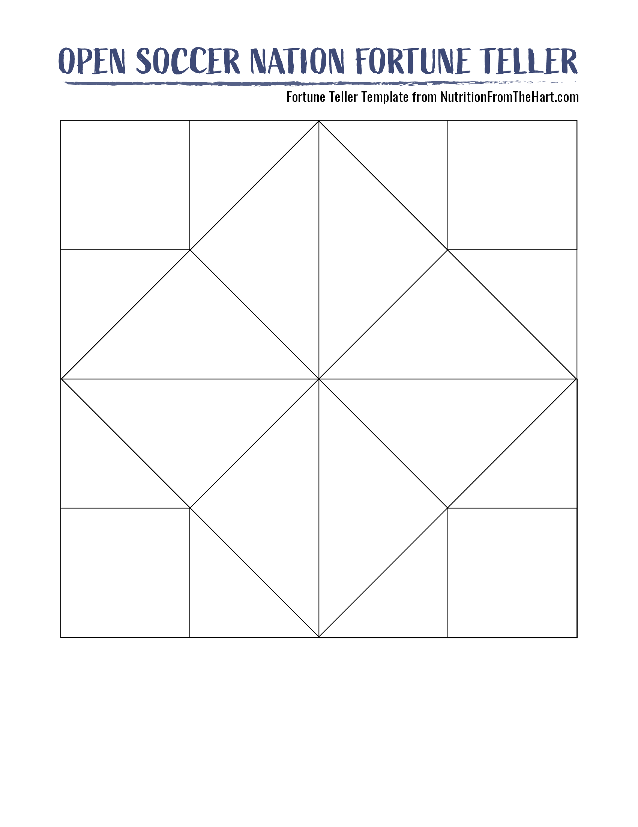




1
BLUEBERRY
PASS
2
Stack 2 cups 10 feet away. Pass to knock down the cups.
Blue fruits & veggies help keep your brain healthy and sharp.
DRIBBLE
SPINACH
Dribble forward with 5 touches, turn and dribble back.
Green fruits & veggies help keep your eyes healthy.
Red fruits & veggies keep your immune system strong.
Juggle 5X with your right thigh, then 5X with your left.
STRAWBERRY
JUGGLE
Do 25 alternating toe taps on the top of your ball.
Purple fruits & veggies lower your risk of heart disease.
4
3
BALL CONTROL
GRAPES
Cut the large outside square of the fortune teller.
Fold in half and in half again – in the opposite direction.
Open out. Turn over so the top is blank. Fold each corner into the middle.
Turn it over and repeat.
Turn so you can see the pictures, fold each corner to create a square showing 4 pictures.
Fold so words come together and touch.
Slide thumb and pointer finger under pictures and all pictures together in fortune teller form.
You’re ready to use the fortune teller!
Notes:
Helpful Fortune Teller Videos
How to cut and fold your fortune teller: https://www.youtube.com/watch?v=xsK4RQv4Cug&feature=youtu.be
How to play the fortune teller game: https://www.youtube.com/watch?v=3Jb0cMumKNE&feature=youtu.be
For more fortune tellers visit: https://nutritionfromthehart.com/2020/03/21/fortunetellers/

