Slide 1
WHAT IS SKILL-RELATED FITNESS?
PHYSICAL & EMOTIONAL

Slide 2
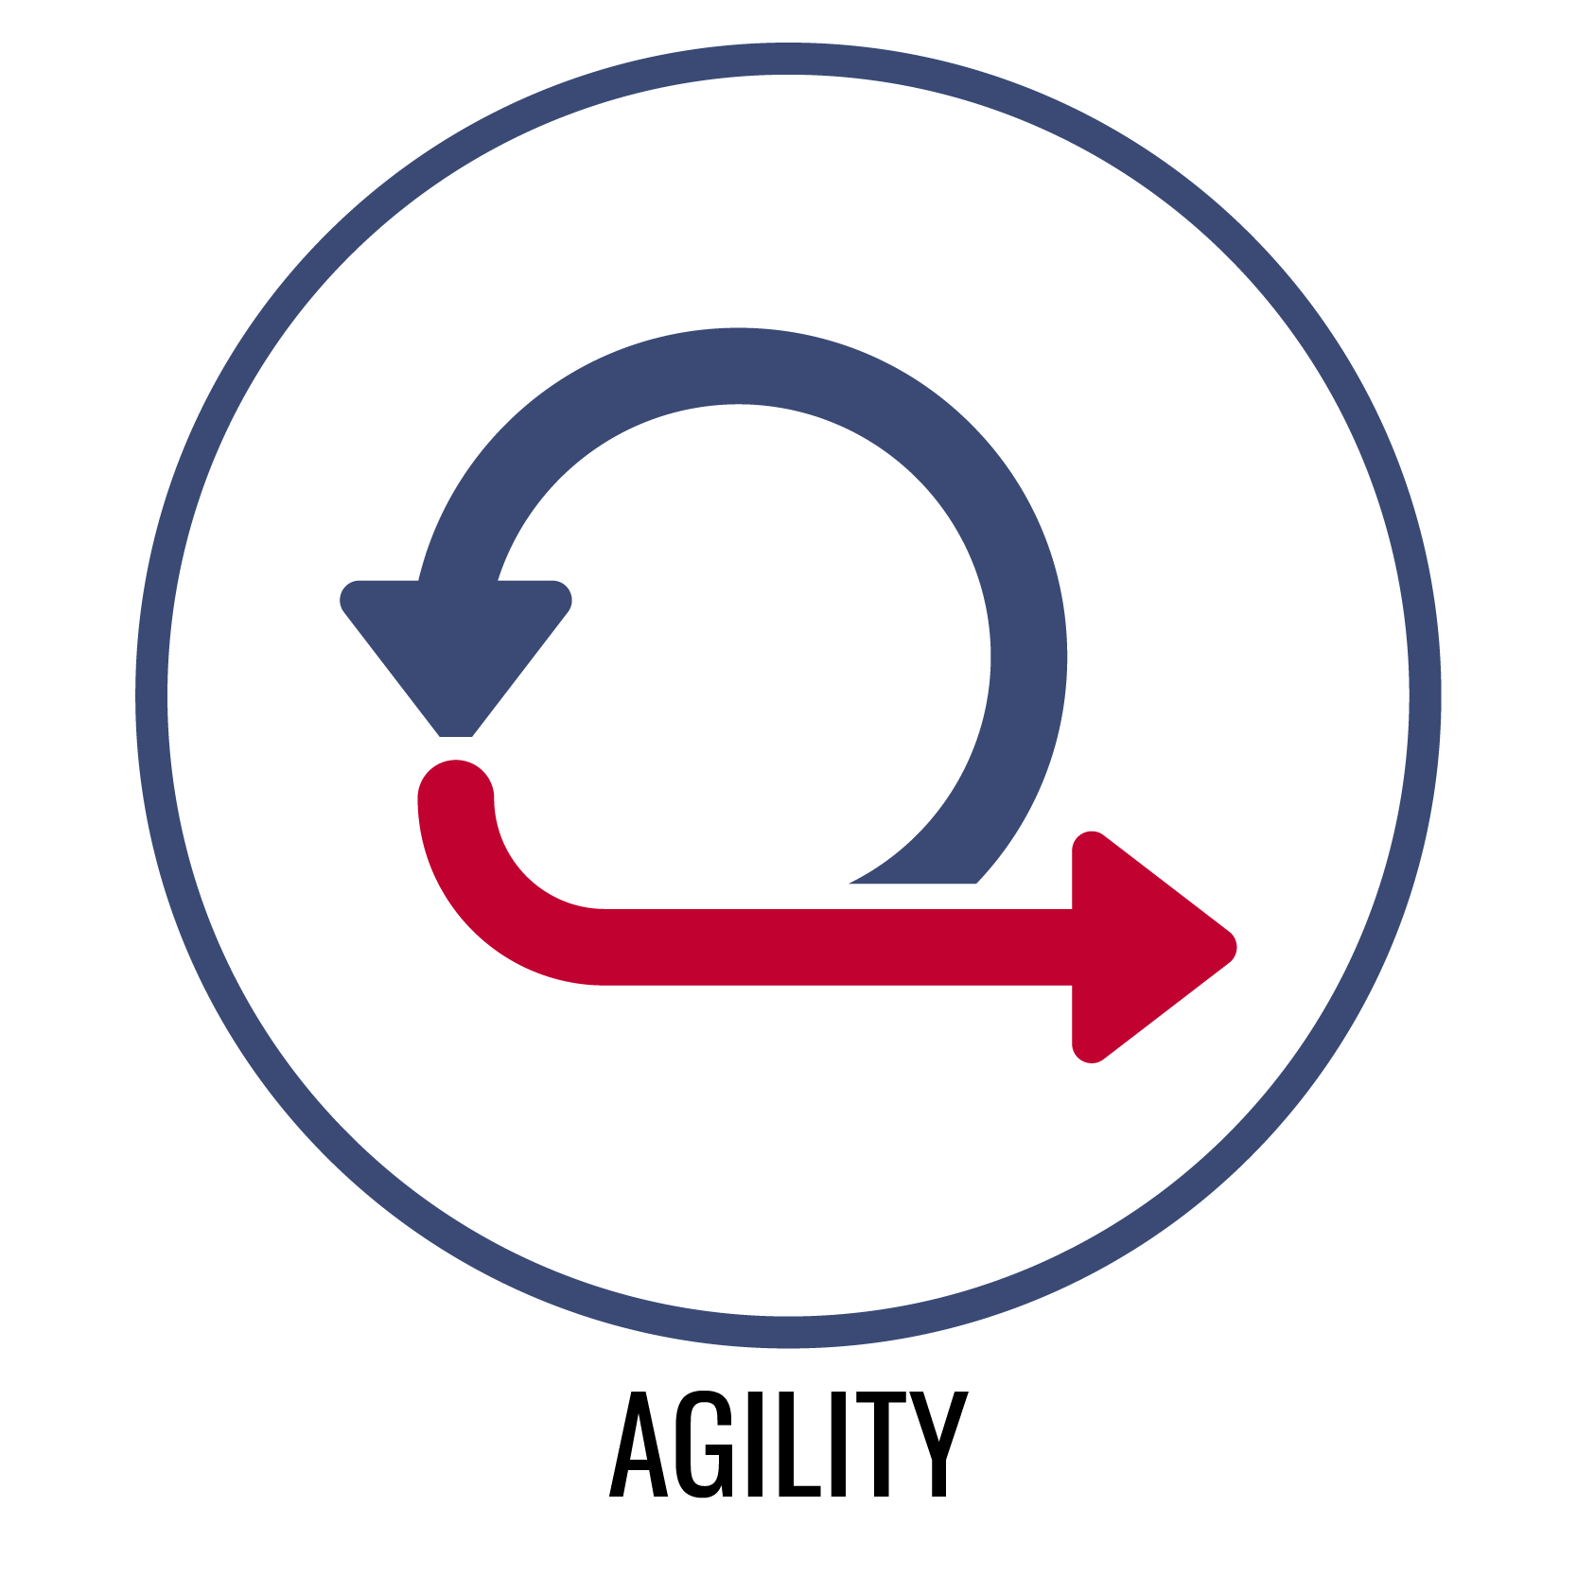
AGILITY
Physical Agility
The ability to change body position and direction quickly and efficiently.
Emotional Agility
The ability to respond positively and optimistically in a variety of social and emotional situations and to regain optimism when negative events occur.

Slide 3
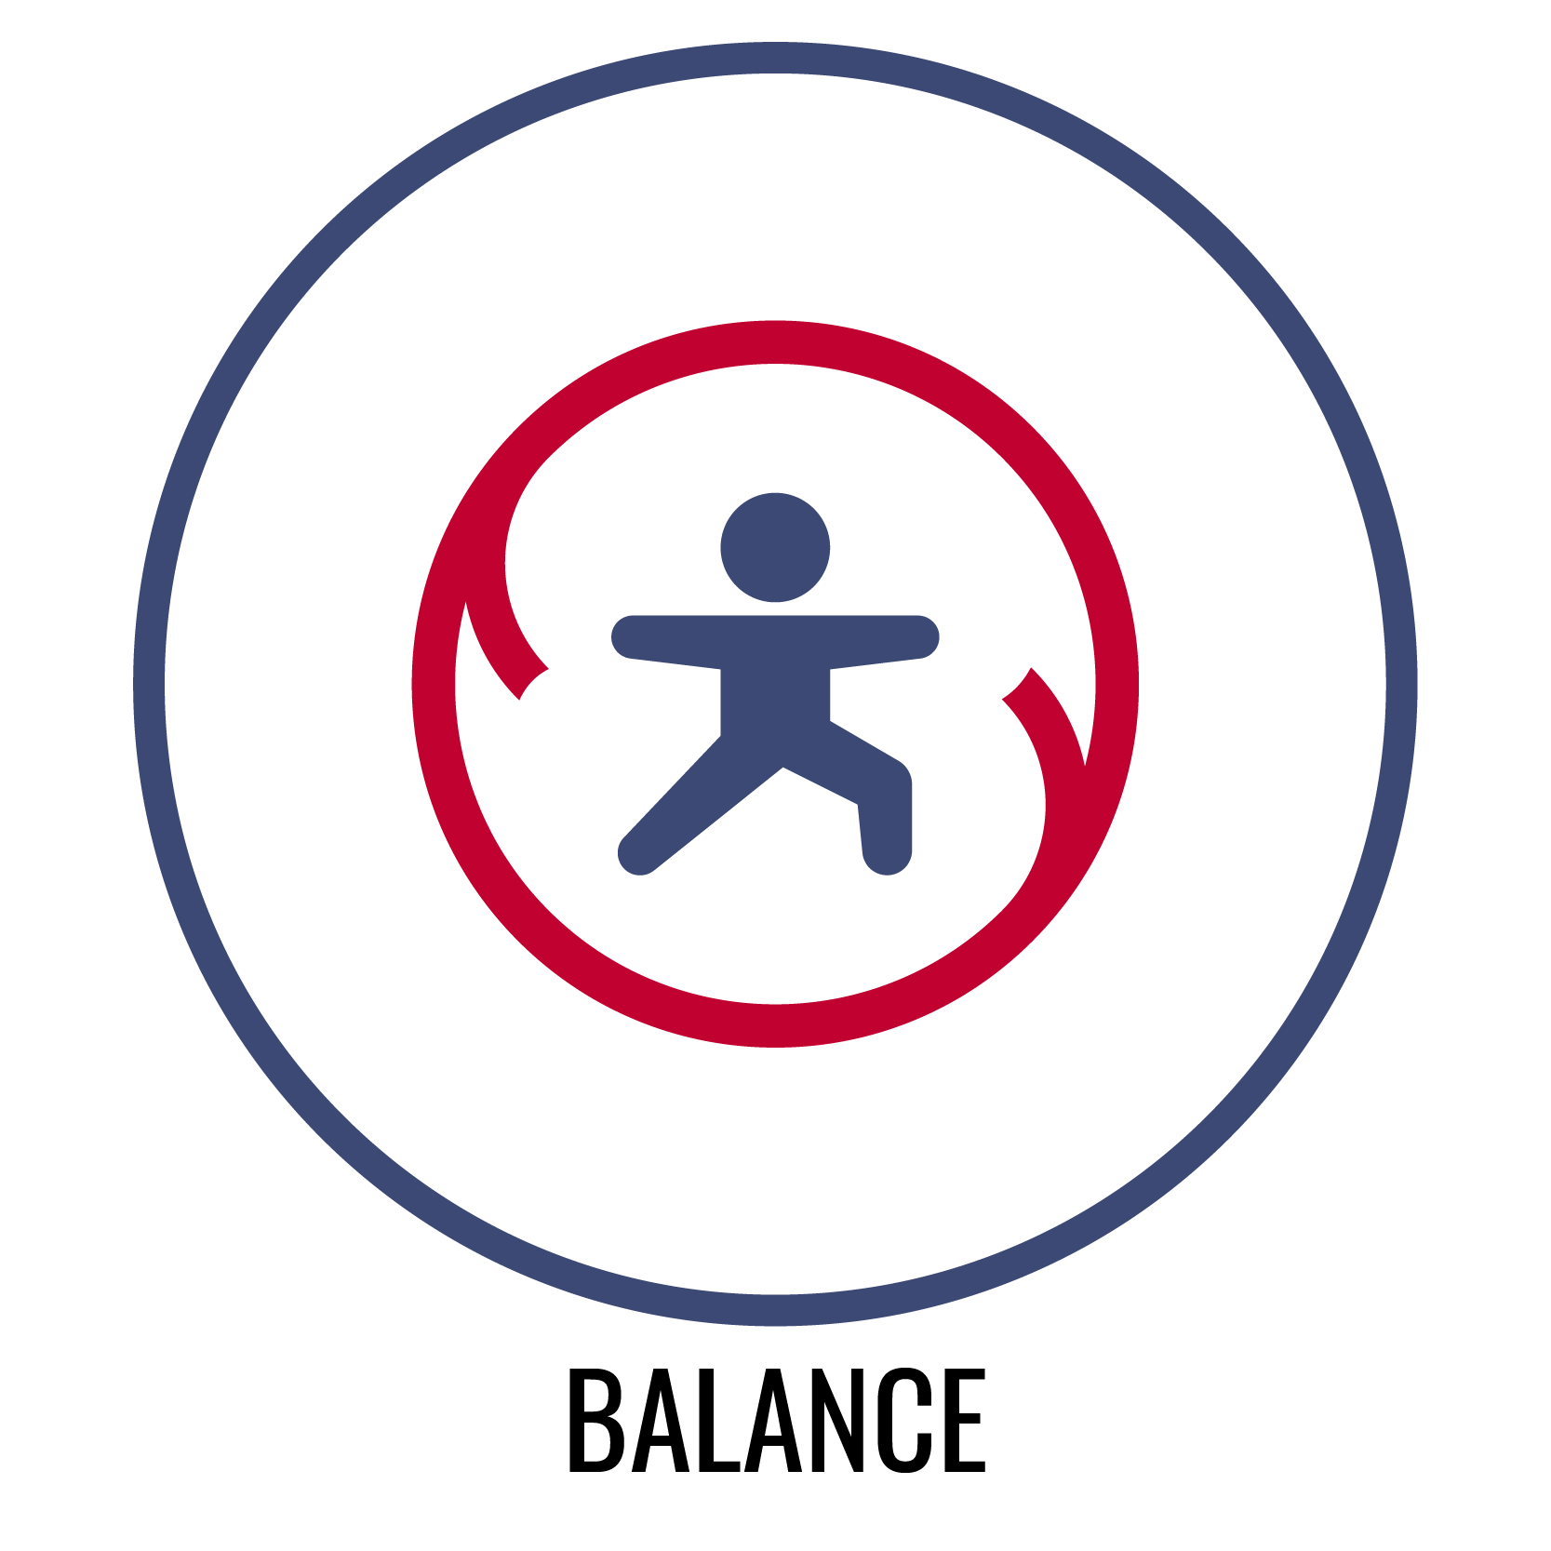
BALANCE
Physical Balance
The ability to adjust the distribution of weight in order to remain upright and/or steady.
Emotional Balance
The ability to stabilize the emotional response to a potentially unstable social and emotional situation.

Slide 4

COORDINATION
Physical Coordination
The ability to combine movements of several parts for a focused purpose or task.
Emotional Coordination
The ability to empathize with others and respond appropriately and productively to provide social and emotional support.

Slide 5

POWER
Physical Power
The ability to quickly produce maximum force.
Emotional Power
The ability to apply the energy created from an emotional response (e.g., anger, sadness, frustration) in a positive and constructive way.

Slide 6

REACTION TIME
Physical Reaction Time
The ability to quickly and effectively respond to a stimulus through purposeful movement.
Emotional Reaction Time
The ability to quickly regulate an emotional response when faced with a variety of immediate social and emotional challenges.

Slide 7
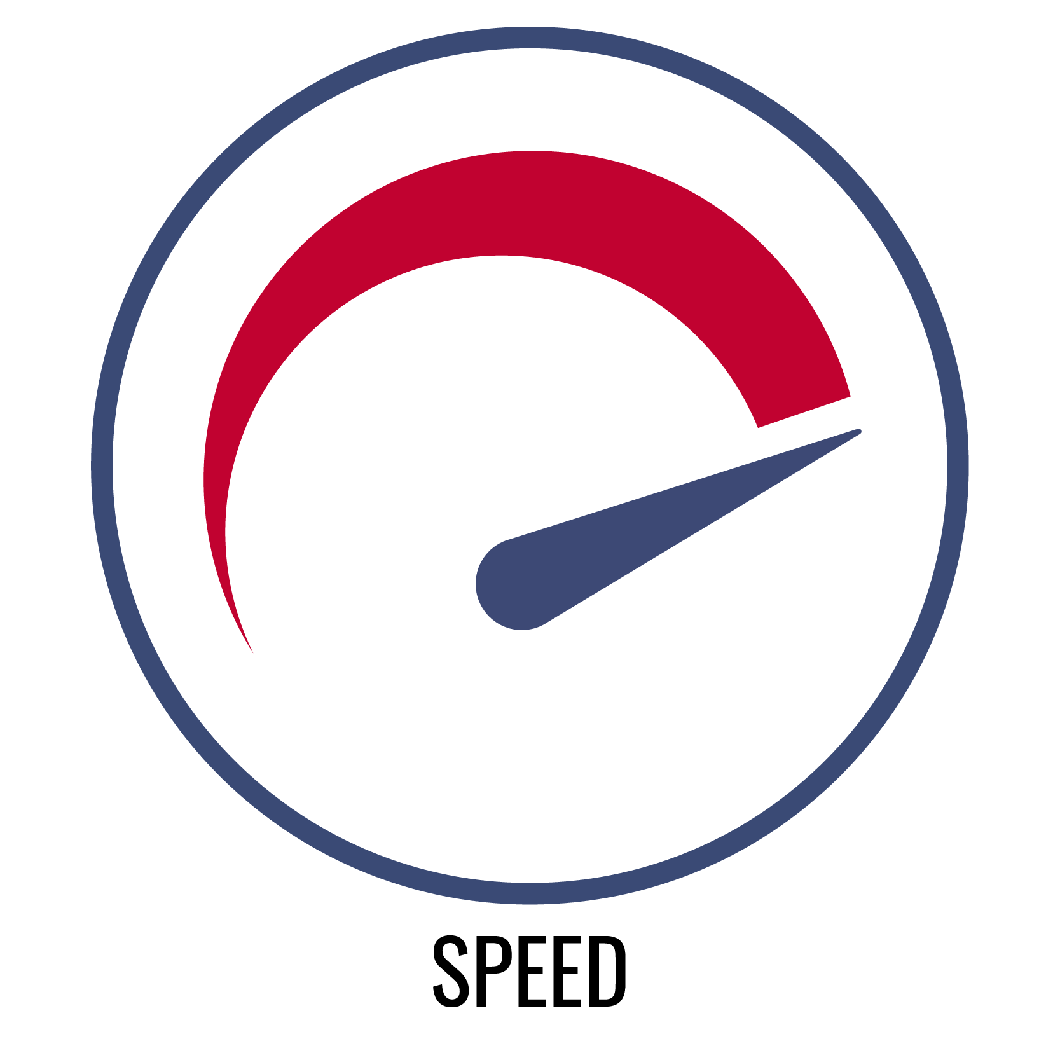
SPEED
Physical Speed
The ability to move the body quickly from one point to another.
Emotional Speed
The ability to use personal enthusiasm to improve the emotional state of others.

