Slide 1
Memory Plate
Nutrition Game Cards

Slide 2
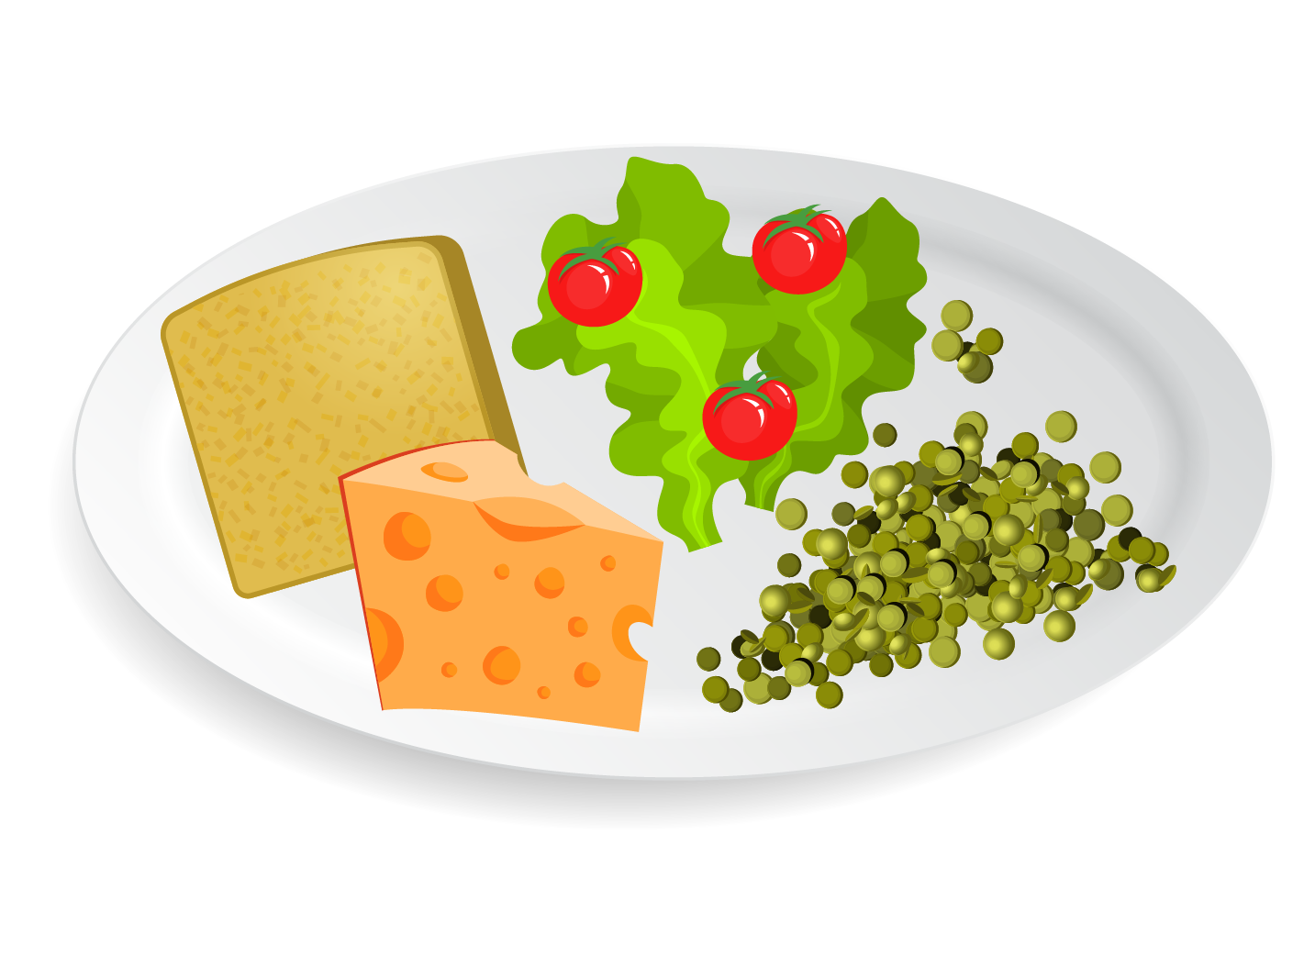

Slide 3
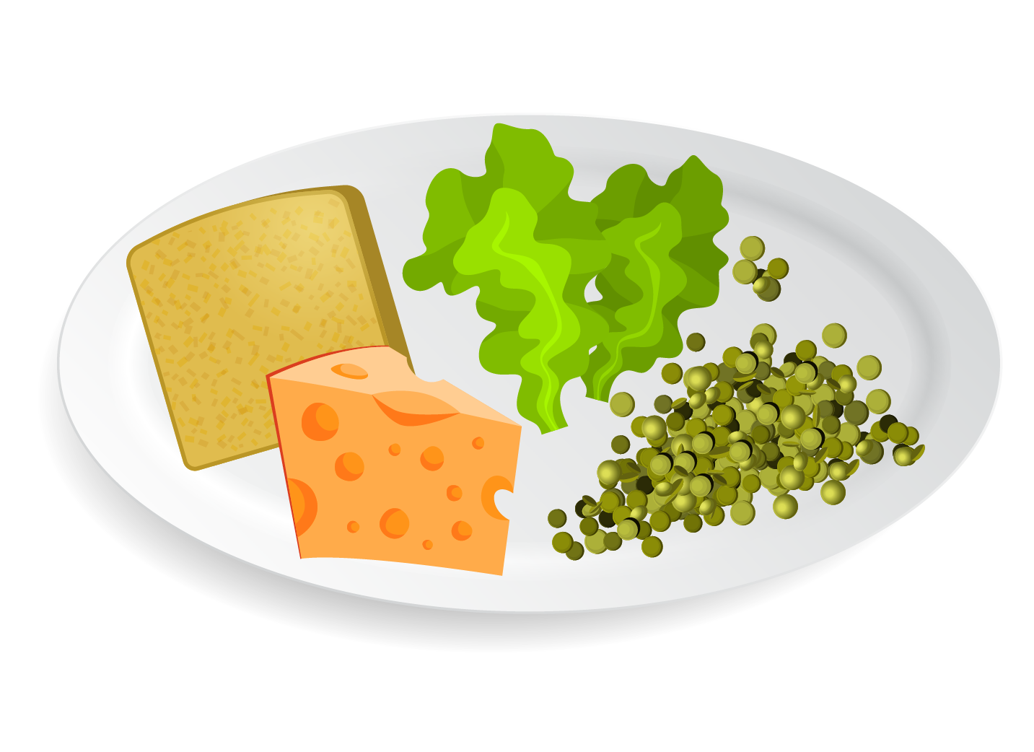

Slide 4
SQUATS

Slide 5
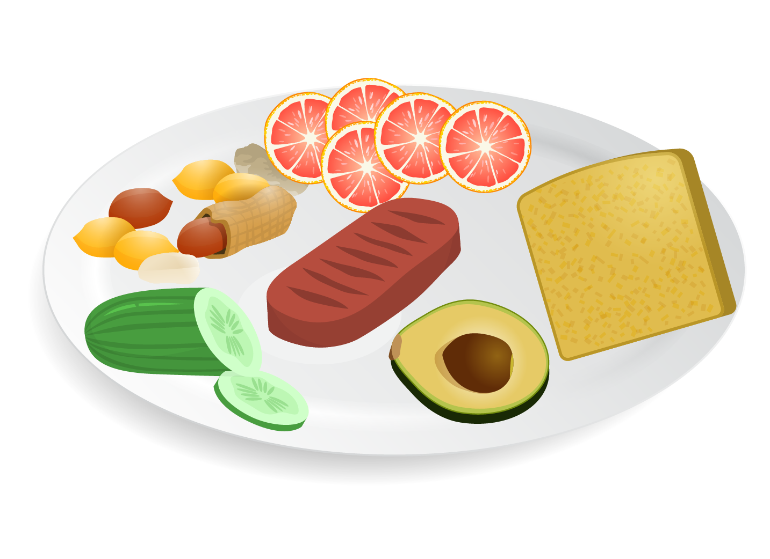

Slide 6
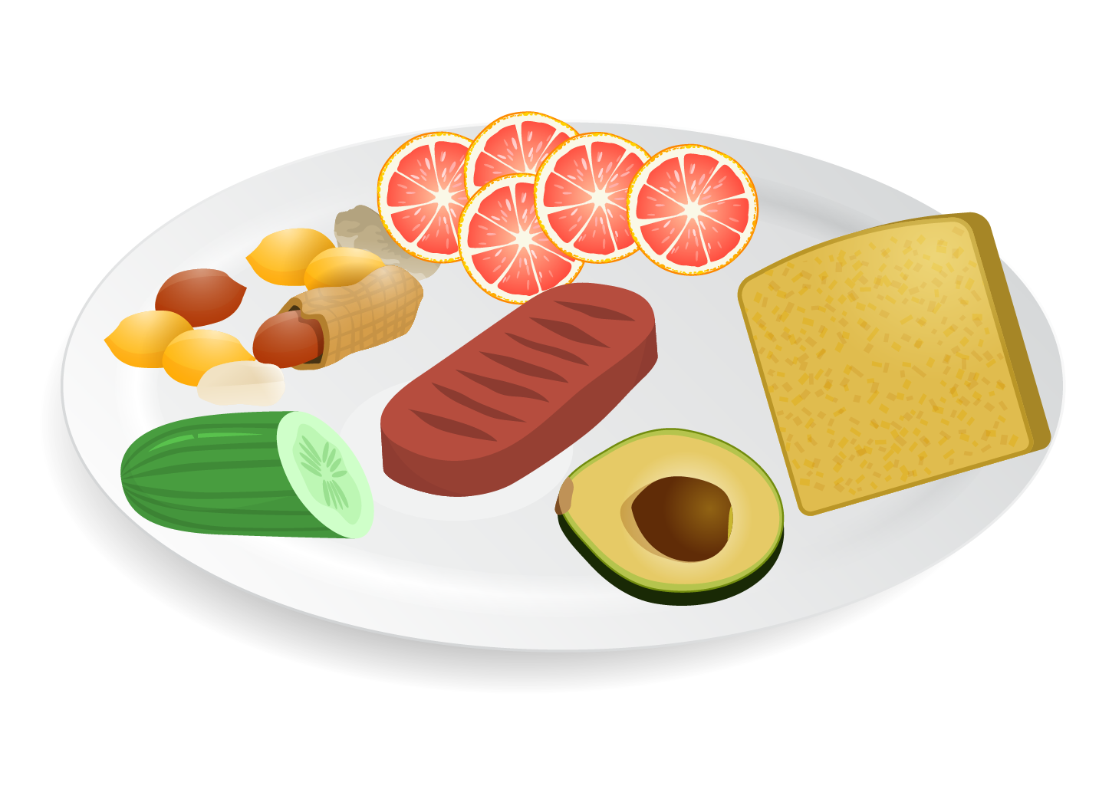

Slide 7
BURPEES

Slide 8


Slide 9


Slide 10
PLANK SHOULDER TAPS

